Slide 1

Look and Live
Notes:
Stories are powerful. If anything moves us as people, it's a good story—literature, film, something told around a campfire. A good story inspires us and moves us to act. Everyone knows it, which is why advertisers, politicians, and preachers all reach for a story when they want to reach you.
So here's something strange. The Bible is, by almost every measure you could pick, the most influential story ever told. The best seller of all time. The most quoted. The most translated. Most people on earth would point to it and say, that one matters. And yet, if you stopped the average person and asked, "What's the story of the Bible?"—most couldn't tell you. In much of the world it isn't taught at all. It's a big book, and it's easy to get lost in the details and never see the shape of the whole thing.
That's what this little book is: the entire Bible, start to finish, told as the single story it actually is.
But I want to offer you more than information. A film only asks you to watch. A novel only asks you to turn the page. This story asks for something more—and gives something more. It invites you to look into it. To look and to live.
So let’s look and live…

Slide 2
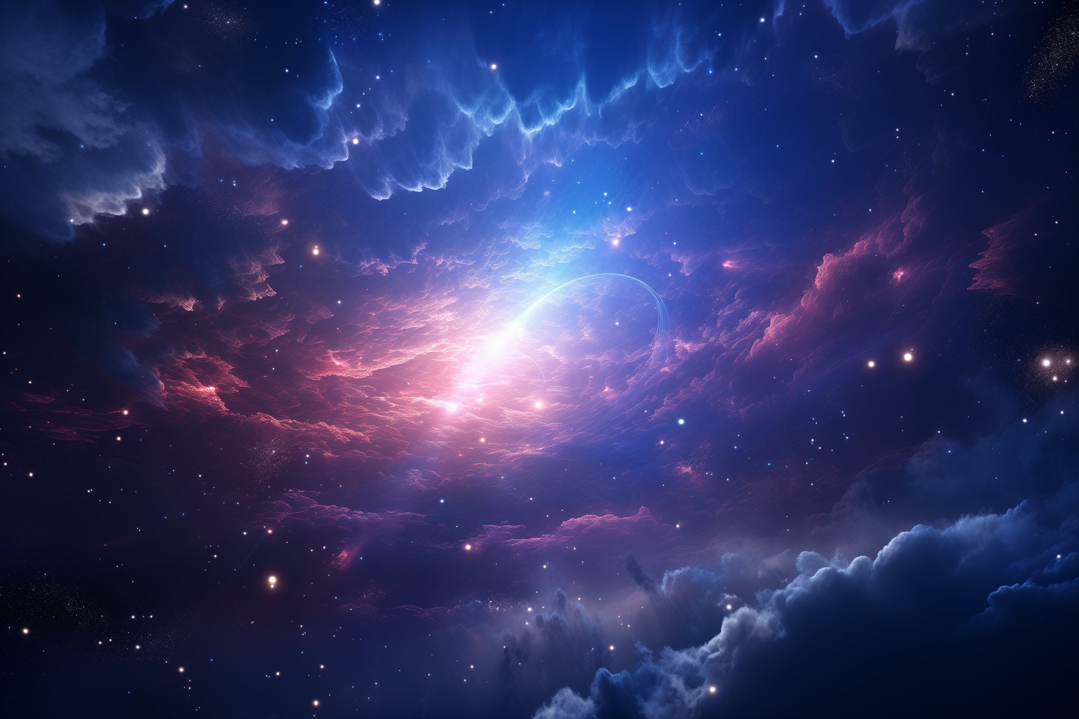
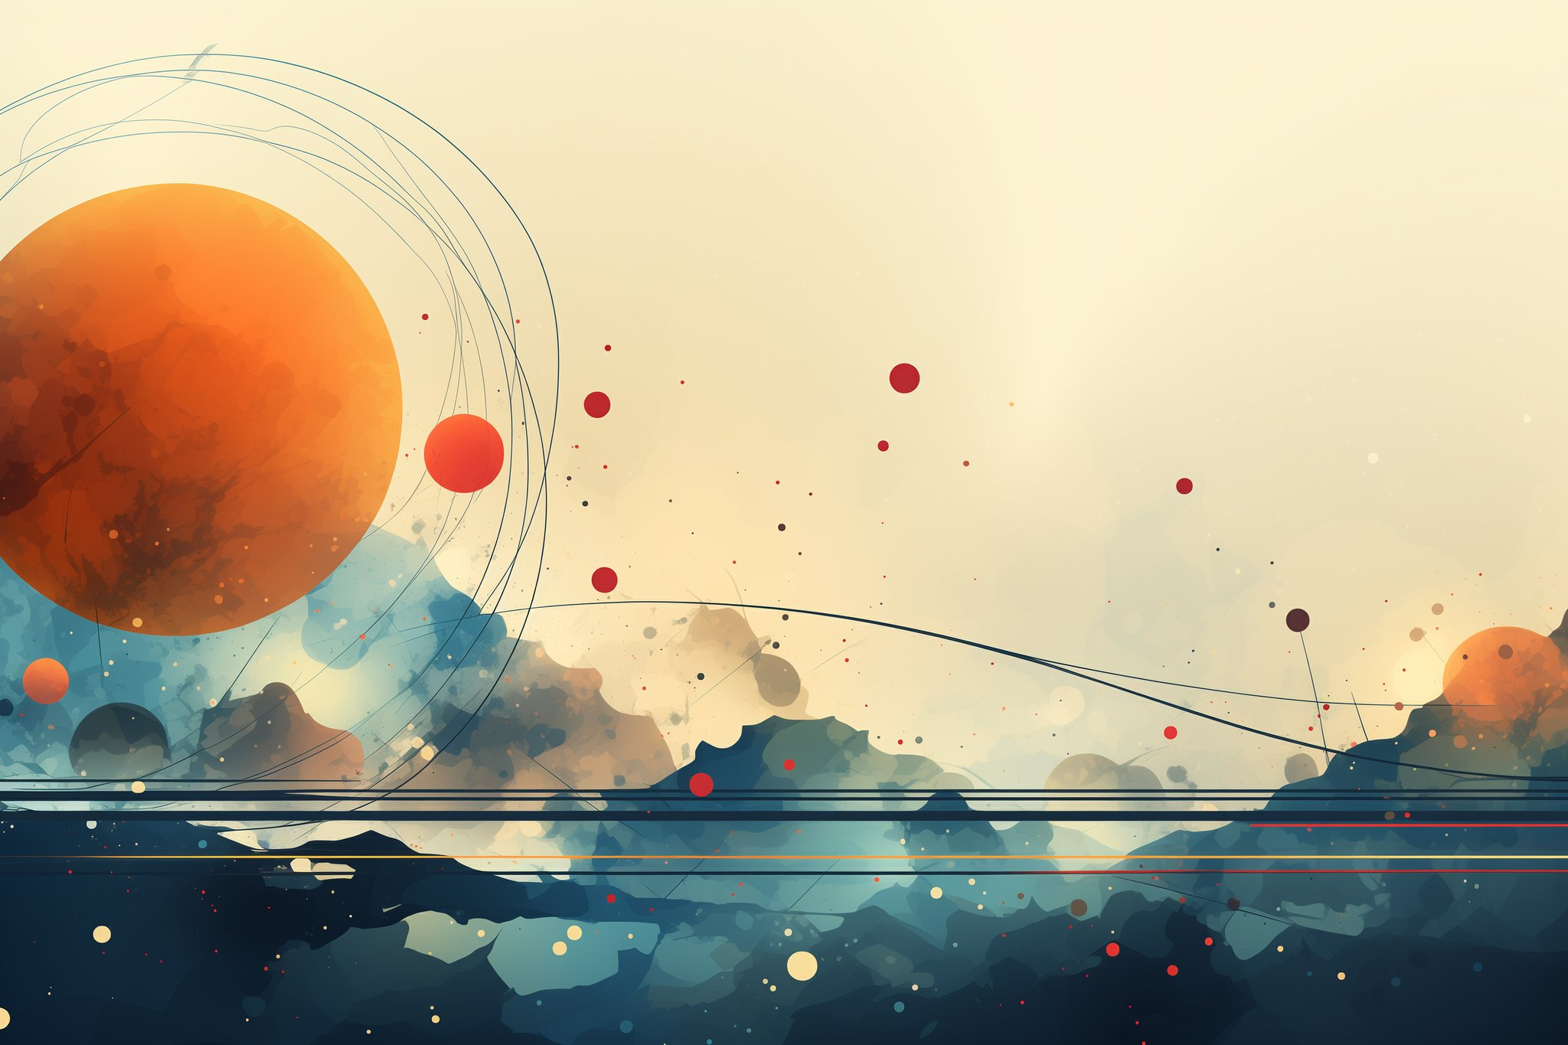
In the beginning, God was.
(Genesis 1:1 / Isaiah 40:26-28)
Notes:
In the beginning, long before people or angels, God was there.
He is an everlasting God, the Creator of the ends of the earth.
He is the first cause. He was not created.

Slide 3
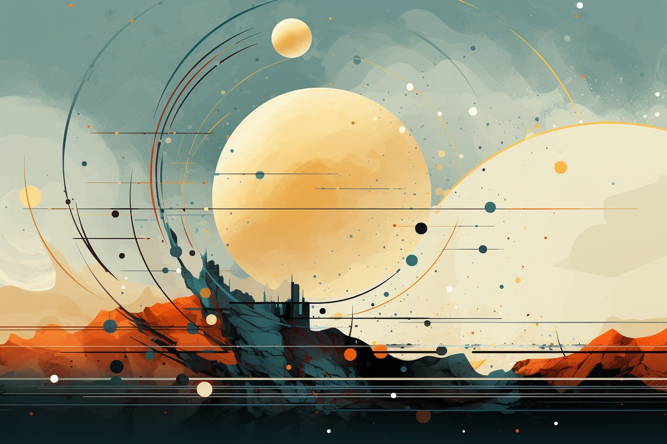
God is a unique spirit.
(John 4:24 / Psalm 103:20-21)
Notes:
The Bible talks about many gods and many spirits, but it only calls one of these gods ‘holy’.
Holy means set apart – special, one of a kind, unique. In fact sometimes the Bible refers to God as the Holy Spirit
One of the first things God did was to make angels. We cannot normally see angels, just as we cannot see God. Both angels and God are what we call spirits. Although the angels are spirits, they are not gods.
These angels or spirits were created to serve God, and they watched and sang as God created the world.

Slide 4
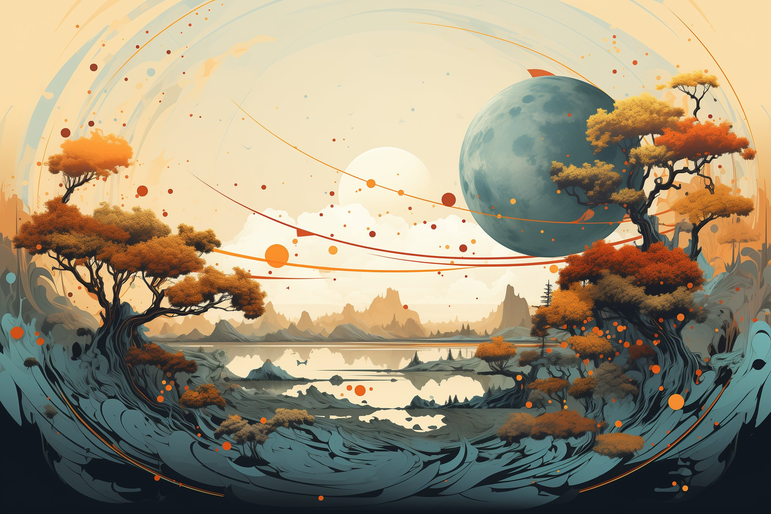
God created the world.
(Genesis 1:3-31)
Notes:
The Bible says that when God created the world, he did it in an extraordinary way. When we make things, we need pencils and paper, computers and printers. Sometimes we use wood, concrete, and huge pieces of equipment.
•However when God made the world, he did not use any tools at all. God just spoke—and there it was!
God said, ‘Let there be light’! [snap] Just like that, light appeared in the darkness.
•The Bible tells us that God made the sun, moon and stars. He placed them in the sky right where he wanted them. God could do that because he is everywhere.
• He made the food we eat, the air we breathe and the water we drink. He made the rivers, seas and mountains. God made all the trees and flowers.
•God made the fish that swim in the sea, as well as the birds that fly in the sky. He also made the animals we see in the forest and on the farm.
Last of all, God made people…

Slide 5
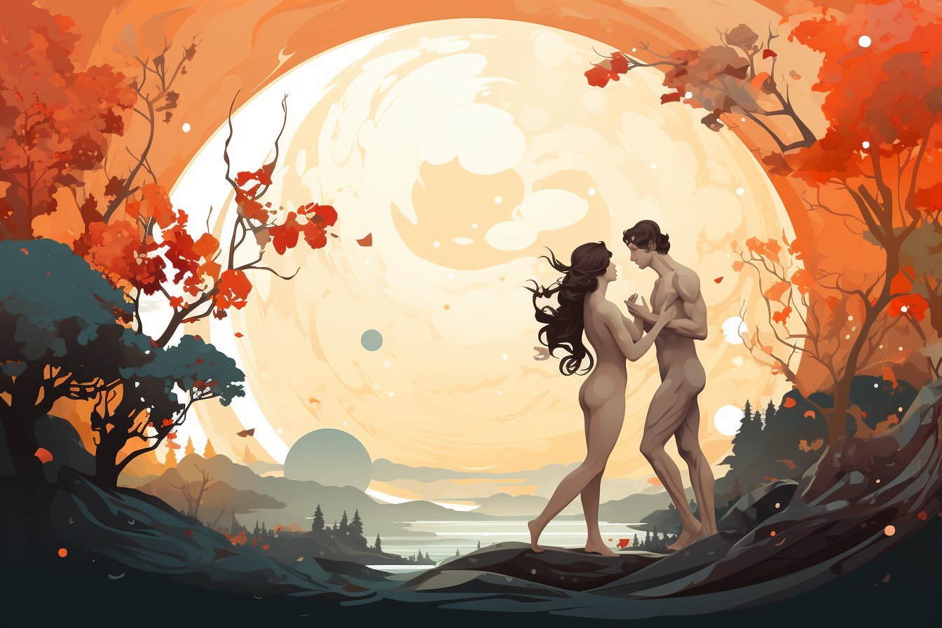
God created Adam & Eve.
(Genesis 1:26-2:23)
Notes:
“God said, ‘Let us make mankind in our image.’”
So God created people with an eternal spirit and soul to enjoy a relationship with Him.
God first made Adam and then Eve, as perfect companions. They fit together. They are the type of what it looks like to be in a marriage relationship. They needed each other. But they needed more than just each other, they needed God since He was their Source of life, and they belonged to Him.
God put them in the perfect Garden of Eden; there was no sickness, evil, pain, or death.
God told them to rule over the earth and to have children to fill it.
All people descendants of Adam and Eve. Adam means “earth”; Eve means “life” or “living”.

Slide 6
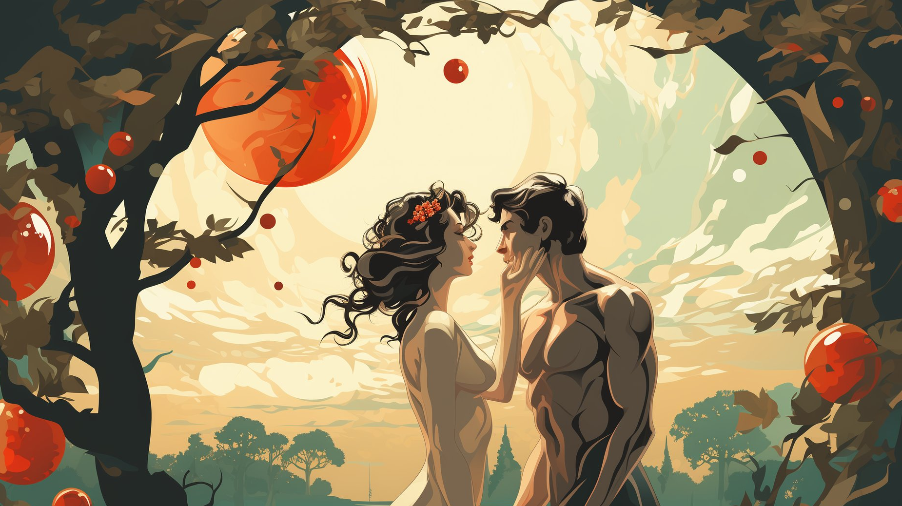
Adam & Eve were free.
(Genesis 2:16-17, 25)
Notes:
It is important to know they were free. I am not talking about the fact that they were naked– though that is an important part of the story even if it makes a little uncomfortable.
God, at the core of His being, is LOVE. And real love is only true love when it’s freely shared.
So, God gave Adam and Eve an opportunity to love Him. He told them they could eat freely from the Tree of Life,and thus live forever with Him. But if they chose to eat from the Tree of the Knowledge of Good and Evil, they would choose independence from God.
God warned them that this would separate them from their Source of life and would result in death.
They had free will, the ability to choose, just like you and I do today.

Slide 7
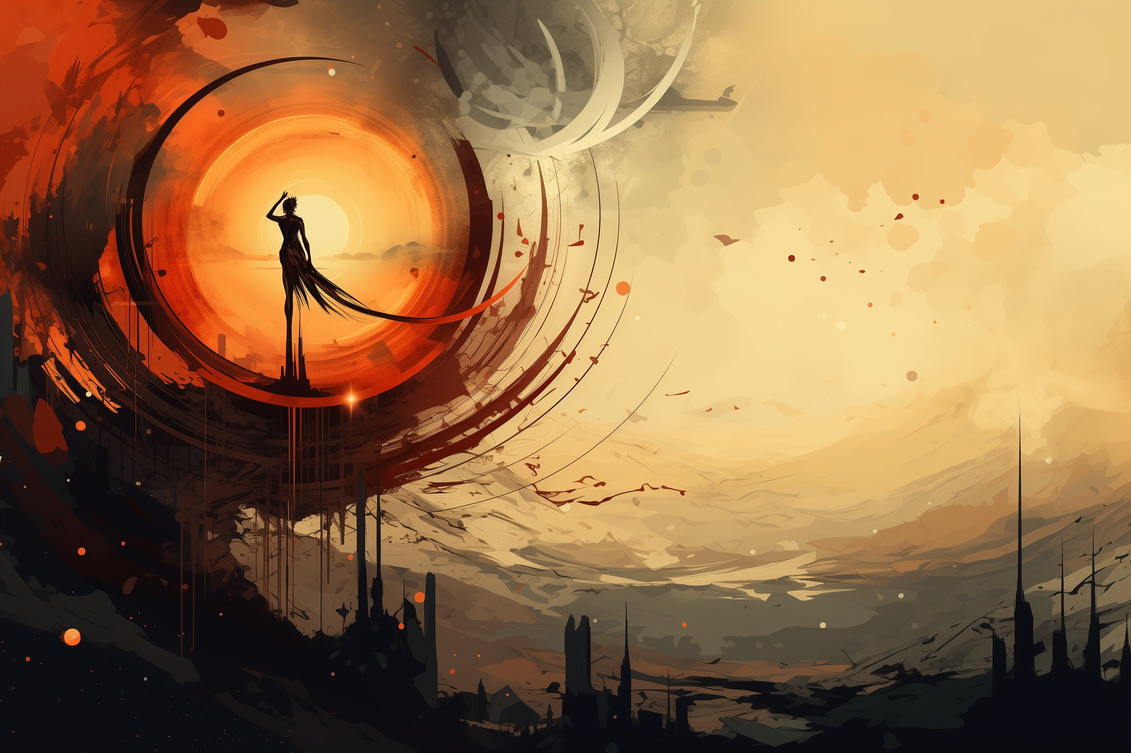
Meanwhile… there was a rebellion.
(Isaiah 14:12-15, Ezekiel 28:12-17, Revelation 12:7-9)
Notes:
Like any good story, there was a conflict. If a story went from introducing the setting and the characters right to happily ever after it wouldn’t be a story.
In the Bible the conflict starts with God’s chief angel. Initially this angel is called halal, the “shining one”. You might be more familiar with the latin form of his name, Lucifer. His beauty, wisdom, and power filled his heart with pride. He wanted God’s throne and to be worshipped like God. He convinced 1/3 of the angels of God to join in his rebellion.
However his plan failed. He and his angels were cast out of the heavens and down to this earth. But having failed with his plan A, he hatched a plan to ensnare Adam and Eve into his rebellion.

Slide 8

Serpent tempts Adam & Eve.
(Genesis 3:1-7, Romans 5:12)
Notes:
The serpent or dragon twists God’s words about not eating from the tree of the knowledge of good and evil. Eve is deceived and reaches out and eats the fruit.
Even worse was Adam– who was standing right there. Rather than protect Eve from these lies, he freely, and knowingly, and willingly chooses to disobey God and takes fruit from Eve and eats it as well.
Two things happen at that moment. 1) They realized they were naked, and immediately try to figure out how to deal with their problem by sewing fig leaves together to make some basic clothing. 2) Spiritually they became separated from God.
Later we discover that God ultimately holds Adam responsible.

Slide 9

God confronts Adam & Eve.
(Genesis 3:9-19)
Notes:
God then calls out to them in Eden, and rather than come humbly and ask for forgiveness– Adam and Eve hide. Just like you and I naturally do when we screw up. However hiding from God doesn’t work.
When God confronts Adam he immediately blames Eve. Eve follows by blaming the serpent. All you parents out there have experienced this with your own kids. Blame shifting. So God doles out truth & consequences.
First God promises that ultimately the women’s descendant will destroy the serpent. The rebellion will be crushed, and it will be carried out a specific descendant of Eve.
Second, Adam and Eve and the whole get consequences as well. Pain in childbirth. Hard labor for food. Our whole earth is under a curse.

Slide 10
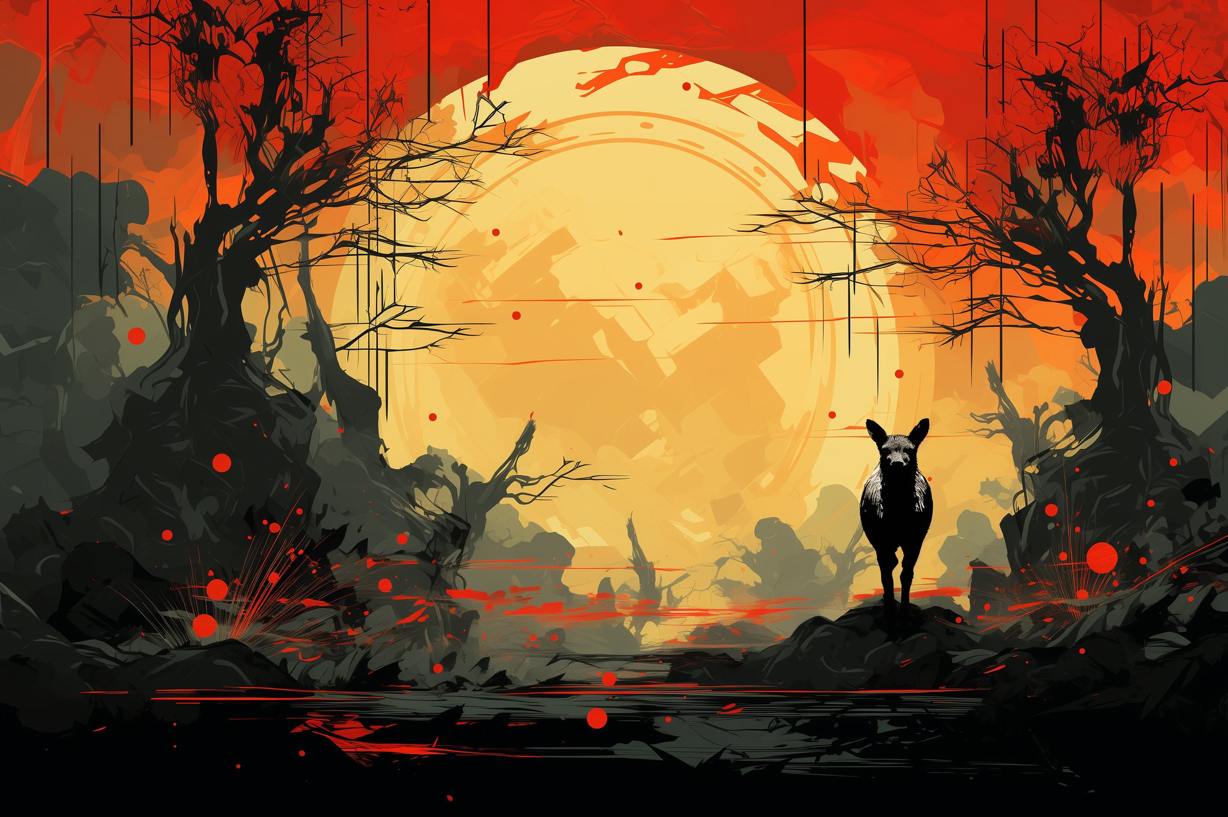
God teaches them about death and sacrifice.
(Genesis 3:20-21)
Notes:
Adam and Eve to this point had never seen any death, God kills an animal and creates a garment made of skin. We call it leather. He does this to illustrate a spiritual principle– that through sacrifice – specifically, the shedding of blood that people can be made presentable.
The blood of this animal and the later sacrifices that their descendants would make would not make them right before God– but it would remind them of the promised descendant of Eve would crush the rebellion and restore the relationship between people and God.

Slide 11
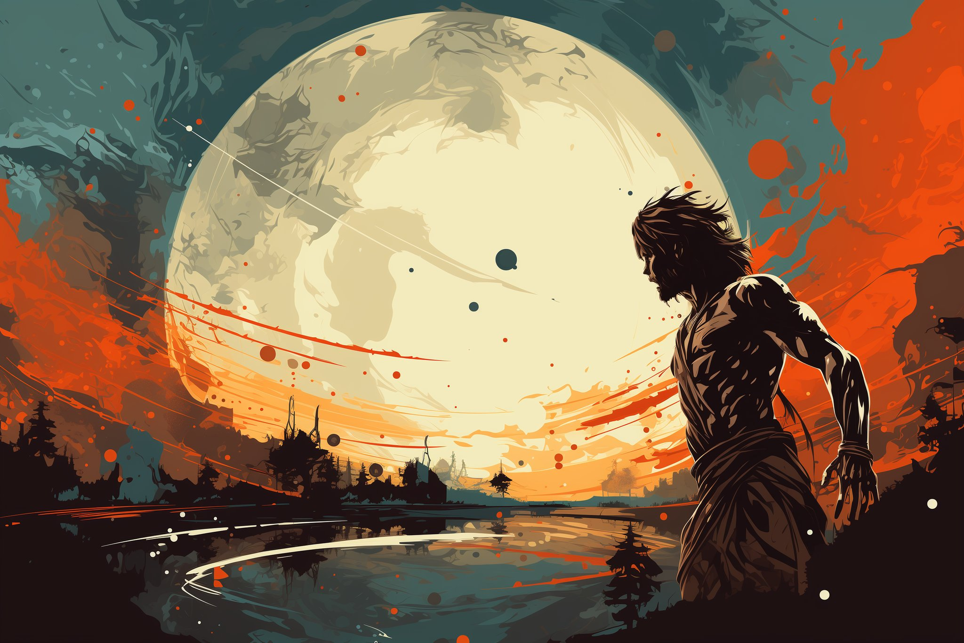
Cain & Abel.
(Genesis 4:1-5)
Notes:
Now Adam and Eve had many many children– two of their kids were named Cain and Abel. Cain was a veggie farmer. Abel was a shepherd. Adam and Eve taught their kids about the sacrifice that God had done for them and the promise of a savior. However when it came time for them to make and offering to God they each had their own ideas about how to do so.
Abel brought the best of his flock. God accepted Abel’s offering since it was done by faith in God’s promise – Abel’s offering pointed to his reliance in the blood of the savior.
Cain on the other hand wanted to worship God with his veggie crops. Just like Adam and Eve had done with sewing leaves together– he was trying to make himself acceptable to God based on his own ideas.
God accepts Abel’s offering, but rejects Cain’s offering. God confronts Cain about this… but rather than listen to God, he decides to kill is brother Abel. Ever since then there has been conflict between those to approach God in God’s way and those approach God in their own way.

Slide 12
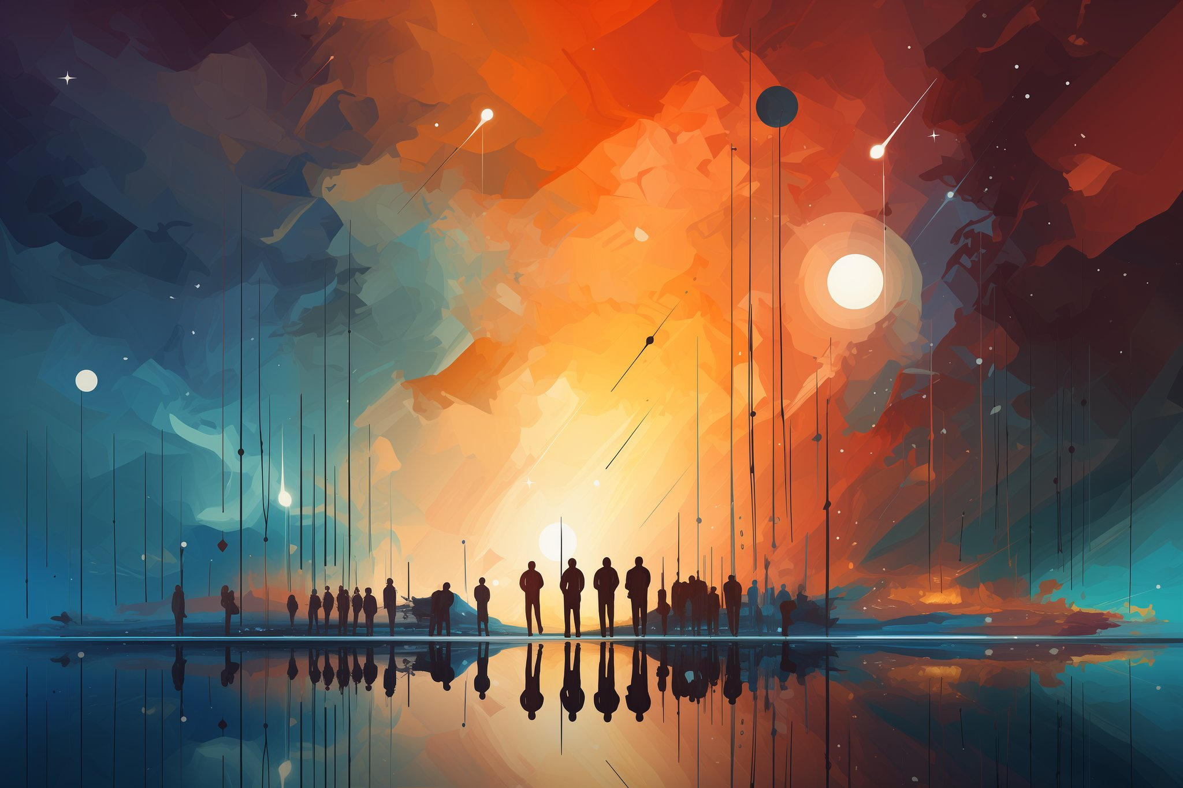
Those first generations…
were bad.
(Genesis 4:6-6:8)
Notes:
There was a lot of babies. Having perfect DNA was a good thing, since there was a lot of cousins involved.
Ten generations after Adam, God was grieved that nearly everyone only thought and did evil all the time!
Because God is HOLY and JUST, He decided to punish mankind’s sin by sending a flood to judge all people.
However some had approached God by faith. They were trusting in a savior. God told him to build a large boat – and Ark, to save anyone who entered it.
Now keep in mind it hadn’t rained yet, so people that it was crazy when Noah preached about God’s ONE WAY to be saved: Get on the boat, you’ll live; if you don’t, you’ll die!
No one outside of his family believed him.

Slide 13

Flood & Noah’s ark.
(Genesis 6:5–7:24; 2 Peter 2:5)
Notes:
Noah and his sons and their wives enter into the Ark, and then God sealed the door of the ark. The fountains of the deep burst forth. The rain began to fall. This water judgement was a gigantic reset.

Slide 14

God: Fill the earth.
(Genesis 9:1-17)
Notes:
After the flood God tells Noah and his kids and their wives to fill the earth. God permits them to eat meat. God commands them to practice civil government– to give consequences to each other.
Now, they were happy to have kids, but spreading out and filling the earth was not what they wanted to do.

Slide 15
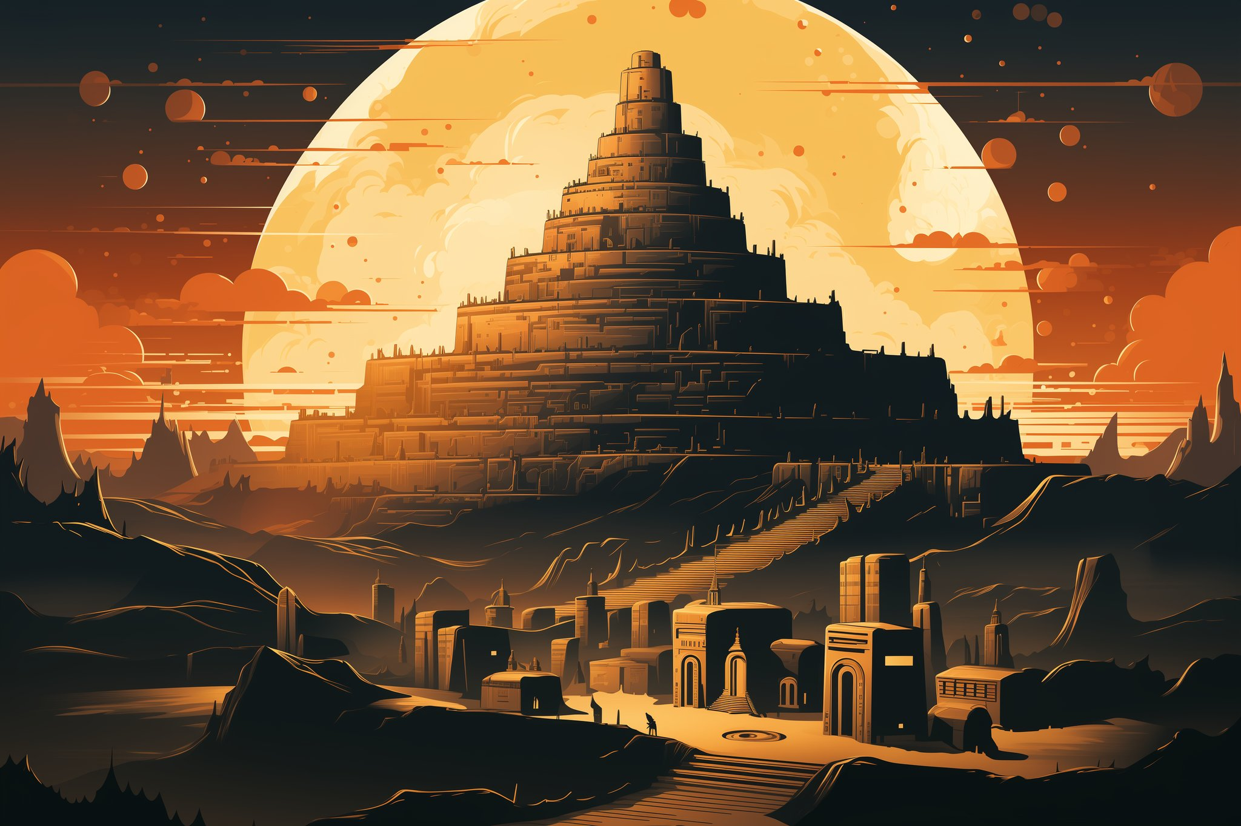
People: Nope.
(Genesis 11:1-9)
Notes:
Instead they gathered in the futile present and built a city– Babylon– and started building a huge tower. A ziggurat.
Just like Adam, Cain, and that first generations of people, they started thinking they could approach God in their own way. They were creating their own entire religion.
You should know it wasn’t just people at work here– the serpent of the garden was continuing to work behind the scenes to deceive humanity.
God steps in and confuses their languages and separates people geographically. This was an act of mercy, as it slows down mankind’s natural sinful tendencies. More recently we are undoing this with globalization and the internet. How’s that working for us?

Slide 16
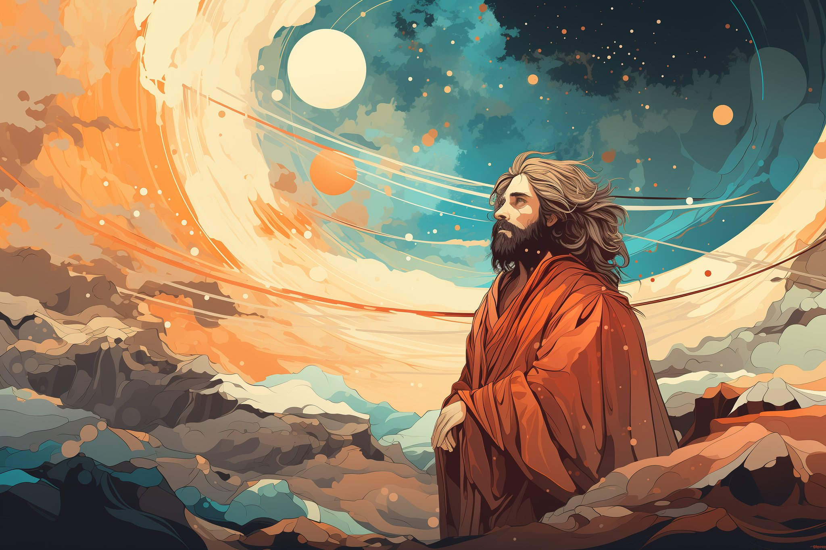
A blessing for all people.
(Genesis 12:3; Genesis 12:1-5; Joshua 24:2-3)
Notes:
While God’s enemy was at work, God was at work too.
This leads us to our next key figure in the story. The man named Abraham. Is is thought that nearly 10% of the world population can trace their lineage to this man. In one form or another, religions that would reference him as a person who interacted with God included 57.6% of the human population.
God calls him to leave his homeland and to resettle in the promised land, that area of the middle east by the Jordan river that we now call Israel. While he and his wife Sarah did not yet have any children (despite trying), God makes him a promise. That he will have a child. That his family would be numbered like the stars in the sky, and one of his descendants would be a blessing for all people. The descendent of Eve that would end the rebellion and restore humanity would come from his family.
Abraham believes God’s promise. We learn that believing what God says– trusting His promises– is what God requires of mankind.

Slide 17
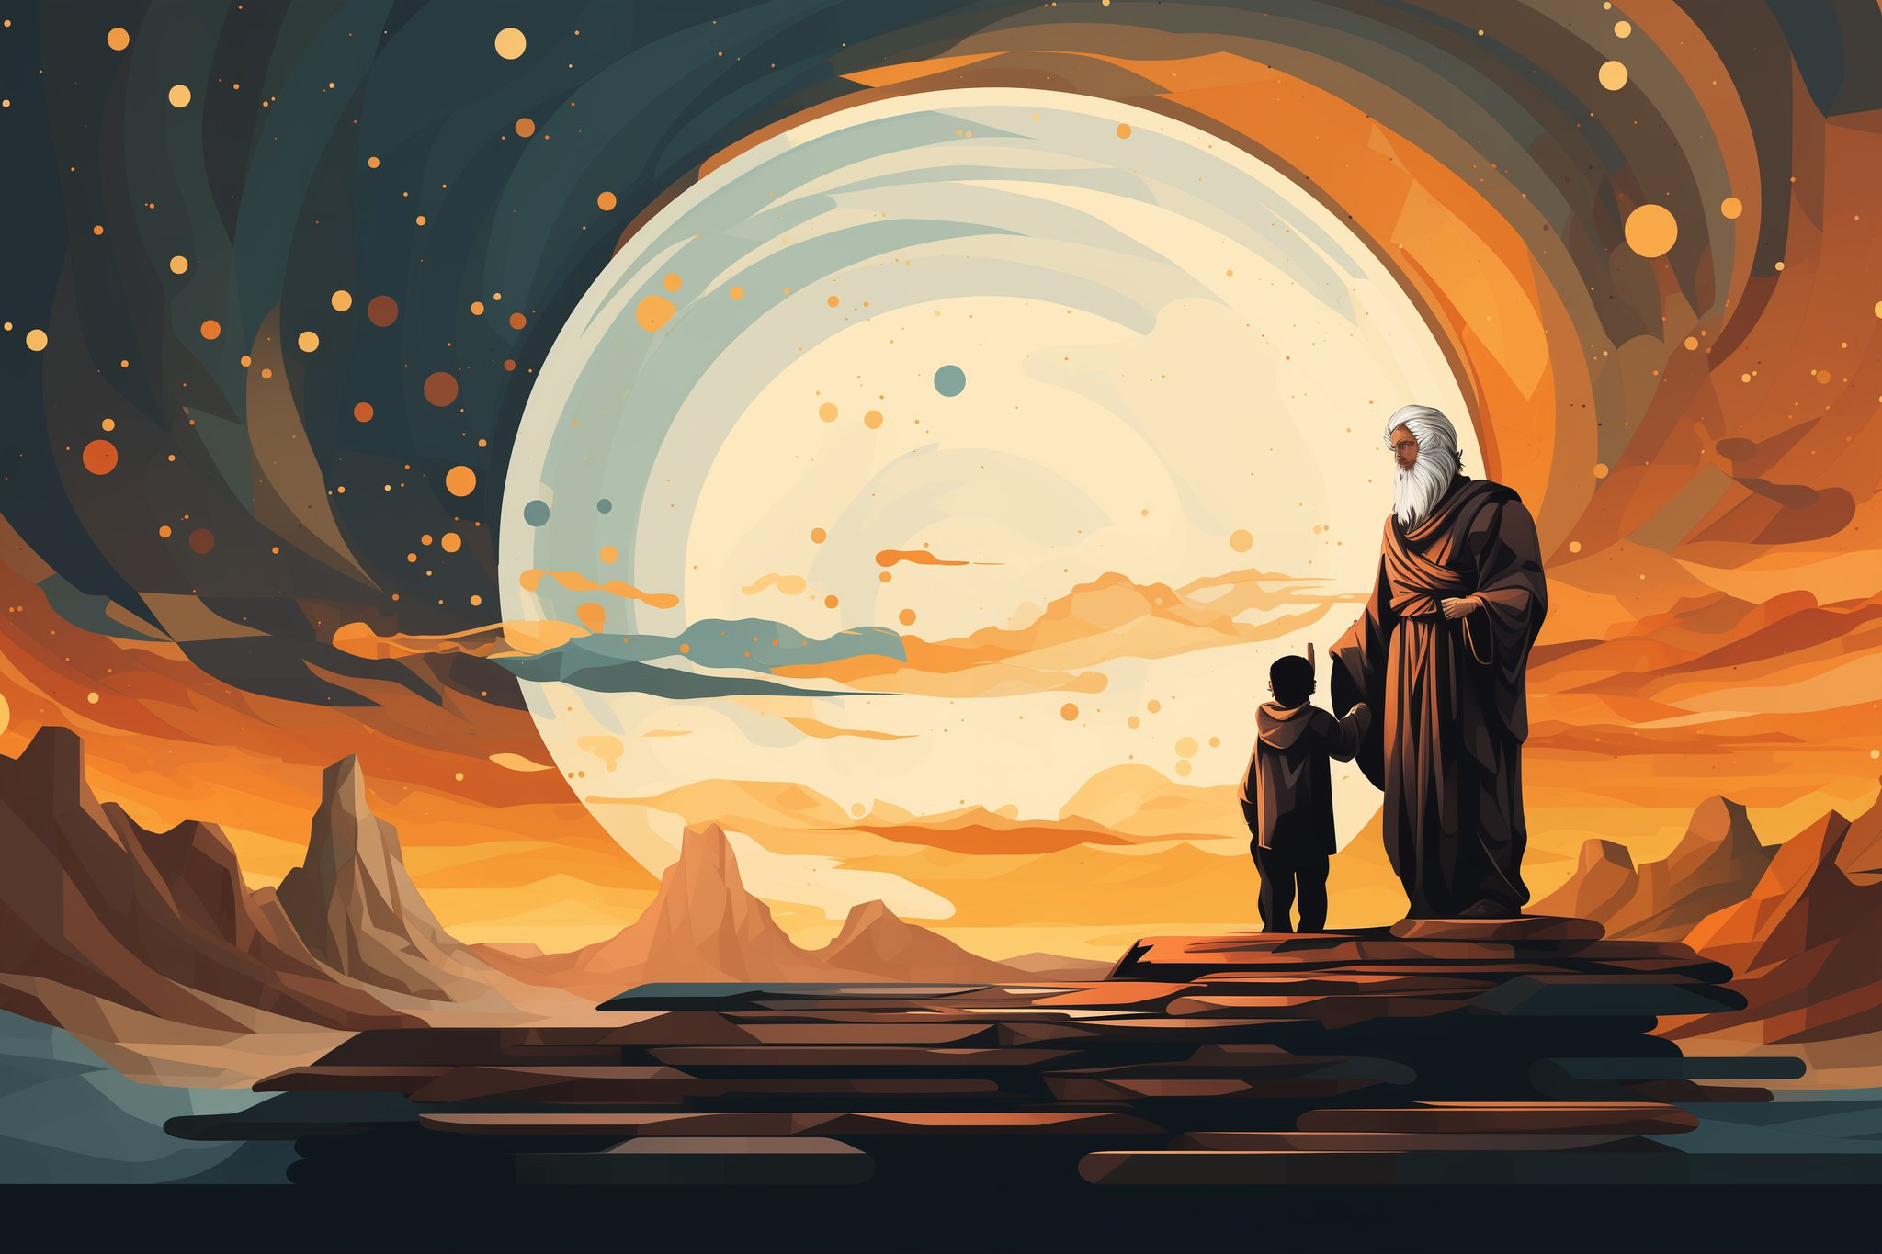
Sacrifice his
one and only son?
(Genesis 22:1-18; Hebrews 11:17-19)
Notes:
Abraham’s life story is sort of like ours. He goes through ups and downs. At one point he and his wife are so desperate to have a son– that they decided to take matters into their own hands and Sarah has him have a child with her servant Hagar. Ishmael is born, but that was trying to accomplish things in Man’s strength and power. That was not how God’s promises work. Eventually, at just the right time, God supernaturally enables Abraham and his wife Sarah to have a baby when she was 100 years old. Their son Issac is born.
But then something crazy happens– toward the end of Abraham’s life God makes a very unusual request of Abraham. He asks Abraham to sacrifice Issac on an alter. He is about to do so before God cry out to him to stop. God provides a ram up on that mountain and we see this imagery of complete trust in God– we learn later that Abraham believed that God would keep his word no matter what, and that God had the power to bring him back to life.
It also serves as foreshadowing how God as Father, would one day offer up His Son.
Abraham’s family keeps growing and eventually it ends up in slavery in Egypt.

Slide 18
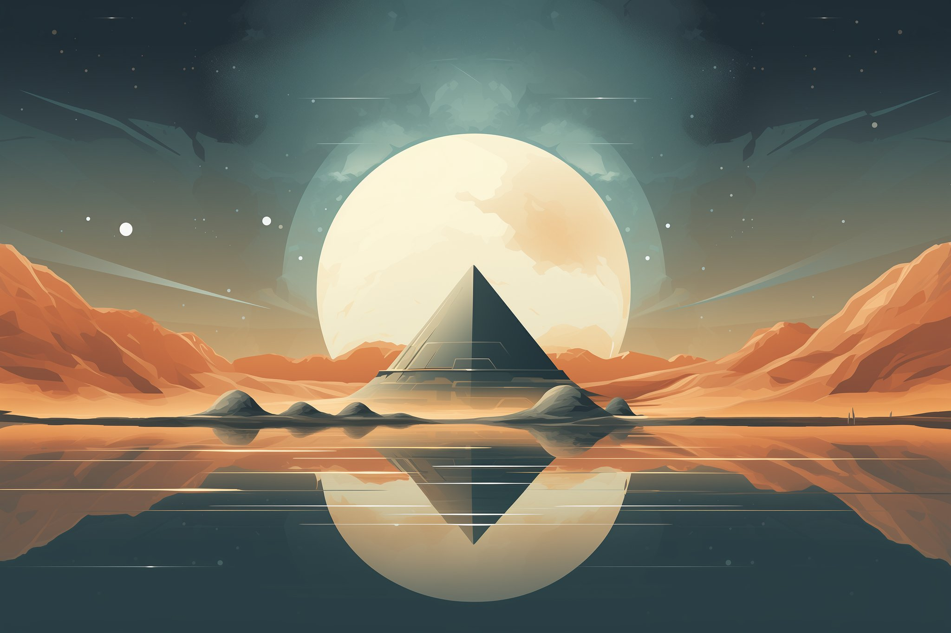
The promise threatened.
(Genesis 15:13-16; Genesis 46:1-34; Exodus 1:8-22)
Notes:
Now God had given them a heads up, that they would be oppressed for 400 years. It happened just the way God said it would. Israel was first blessed– through the work of Joesph, and then enslaved by the Pharaohs of Egypt. During the time of Moses the Pharaoh started to murder all of the baby’s of Abraham’s descendants – then called Israelites. Yes, it was an ethnic genocide– one of many that would be attempted on these people, now called Jews. Why all the genocide? Remember, the serpent was still at work! He was trying to thwart God’s plan and promise. However, God uses Moses and a series of supernatural plagues to reduce his people and to teach the people of Egypt not to listen to these false gods. It culminates in one of the key events in the Bible.

Slide 19

The Passover.
(Exodus 5:1; Exodus 5:1–12:30)
Notes:
The final plague is very severe. God demands the life of every first born male– animal, people, everything living in Egypt. But God gives the Israelites a way of finding grace– they would sacrifice a spotless lamb, and sprinkle its blood on the door posts of their house. When the death angel comes by, he would see the blood and skip over them. They would be passed over. This is also foreshadowing– that Eve’s Savior, one of Abraham’s decedent's would shed His blood and make it possible for an eternal passover.

Slide 20
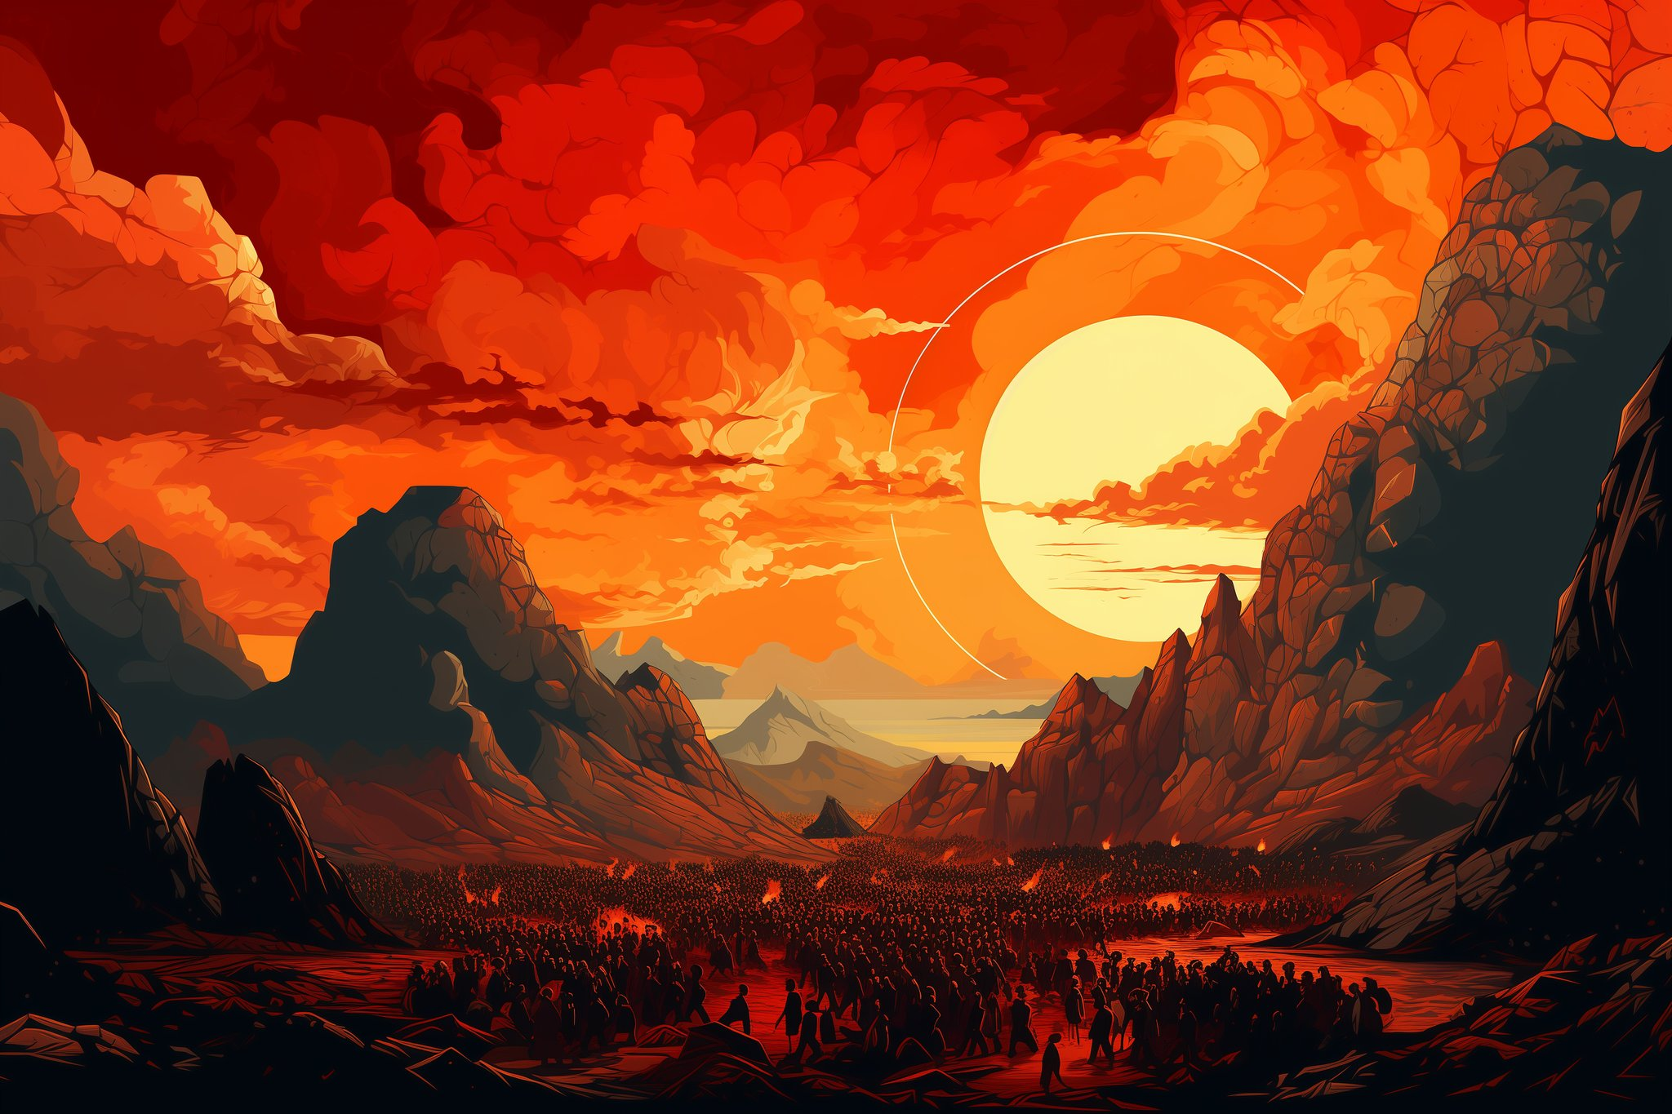
Mount Sinai
(Exodus 19:1–20:21; 24:7; 31:18; Romans 3:18-22)
Notes:
3 months later the Israelites find themself out in the wilderness desert. They had walked across the sea on dry land as God rescued them powerfully from the Egyptians. They arrive at Mount Sinai. Moses goes up the mountain– which is scary looking with fire and lightning enveloped by a cloud.
God makes them an offer. If they would like to enter into a legal covenant with God– the terms are pretty simple. Obey a moral and religious law and you will be blessed more than all people. Disobey it and you will be cursed more than all people. The people quickly said, yep, sign us up. Moses goes up and comes down with the 10 commandments written in stone. They don’t change. A couple days later when Moses is late coming down the mountain they melt down a bunch of gold and cast their own false God idol. Immediately breaking the covenant. What is wrong with these people?
If you recall all the way back from the beginning of the story, the fruit humanity ate was the “fruit of the knowledge of good and evil”. We are able to recognize morality. However we lack the innate ability to consistently do good. God was going to use this nation of people as a huge object lesson for all of humanity– to teach us that we desperately need God’s power and presence to actually be good.
Much later we learn that the purpose of the Law was to learn about sin and our need for a savior. It makes us accountable to God.

Slide 21
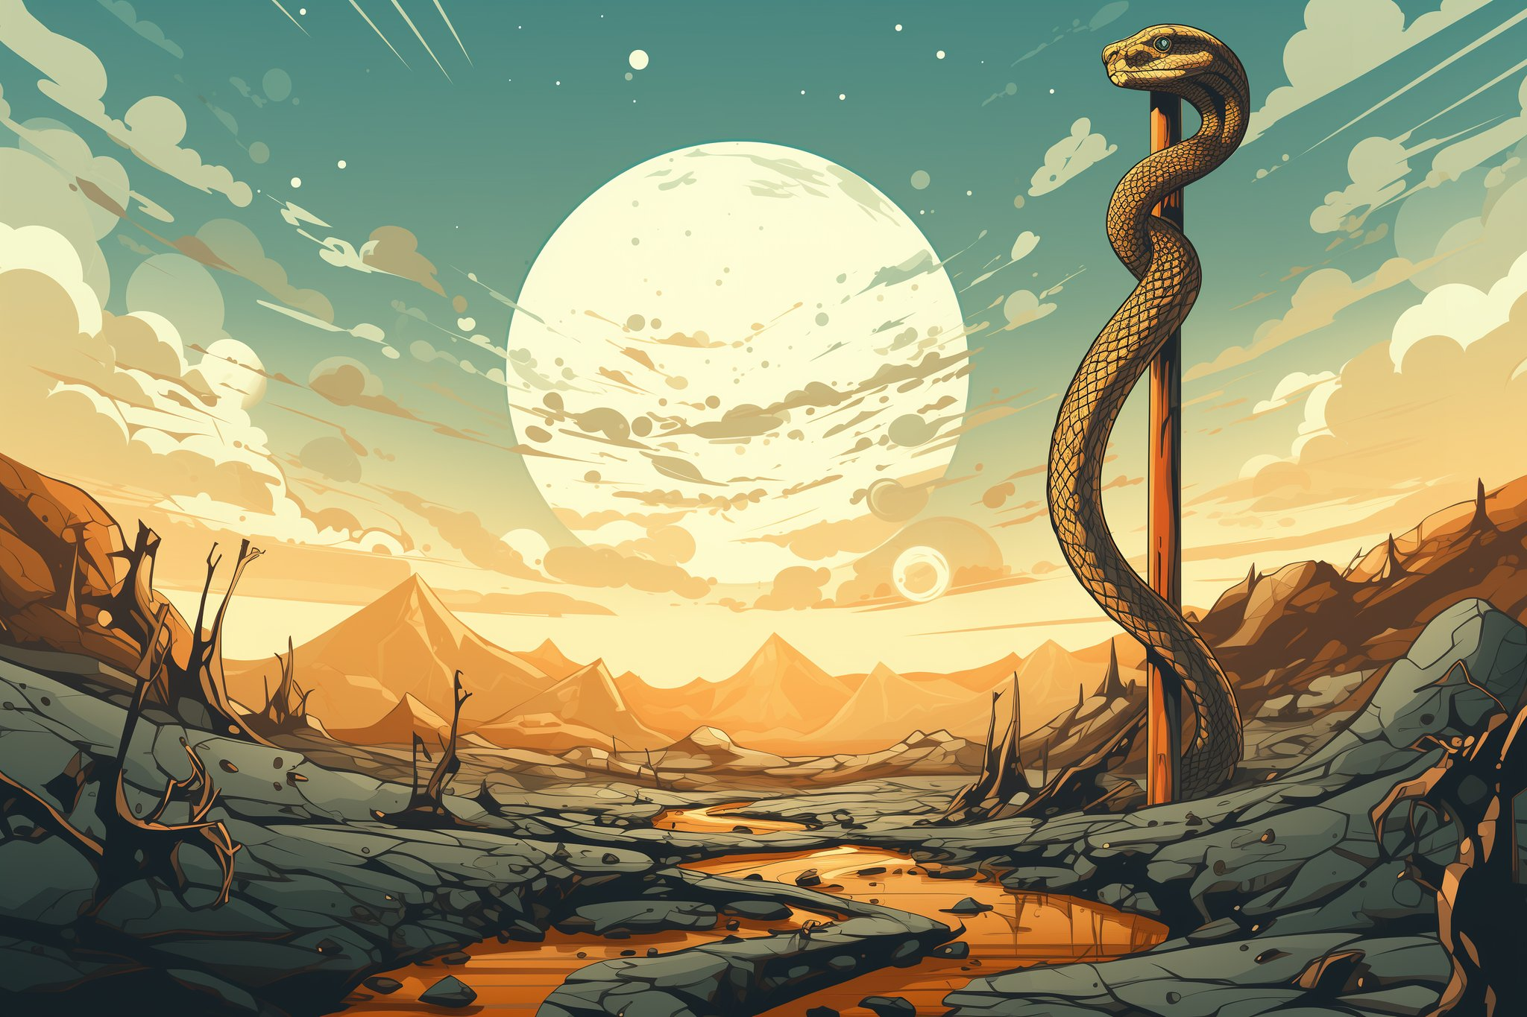
The Bronze Serpent
(Numbers 21:4-9; John 3:14-16)
Notes:
Thus the rest of the story of Israel is a bit of a tragedy. If they would obey they would be blessed, but most of the time they are not obeying– and subject to all sorts of consequences. However, it also provided God with many opportunities to teach us about his grace and redemption.
On early incident in the book of Numbers you find the Israelites grumbling and disrespecting God. As a result God sends poisonous snakes there way– people are bitten are starting to die. The Israelites confess their mistake and Moses prays to God. God tells him to make a bronze serpent and lift it up on a pole. Whoever is bitten and then looks to the lifted up bronze serpent is healed and will live.
This also foreshadows how Eve’s savior would be lifted up, and all those who look to him by faith will be healed and live.
Seriously, it is the context for the most well known verse of the Bible…

Slide 22
John 3:14-15
And just as Moses lifted up the serpent in the wilderness, so must the Son of Man be lifted up, so that everyone who believes will have eternal life in Him.
(John 3:14-16)
Notes:
Thus the rest of the story of Israel is a bit of a tragedy. If they would obey they would be blessed, but most of the time they are not obeying– and subject to all sorts of consequences. However, it also provided God with many opportunities to teach us about his grace and redemption.
On early incident in the book of Numbers you find the Israelites grumbling and disrespecting God. As a result God sends poisonous snakes there way– people are bitten are starting to die. The Israelites confess their mistake and Moses prays to God. God tells him to make a bronze serpent and lift it up on a pole. Whoever is bitten and then looks to the lifted up bronze serpent is healed and will live.
This also foreshadows how Eve’s savior would be lifted up, and all those who look to him by faith will be healed and live.
Seriously, it is the context for the most well known verse of the Bible…

Slide 23

Israel’s Cycle
(Judges 2:7-19, etc.)
Notes:
Now with this slide I am summarizing many, many stories. If this was an hour or two long session, this section would be expanded a bit. A significant portion of the Old Testament tells this story time and time again. Here is how it works.

Slide 24
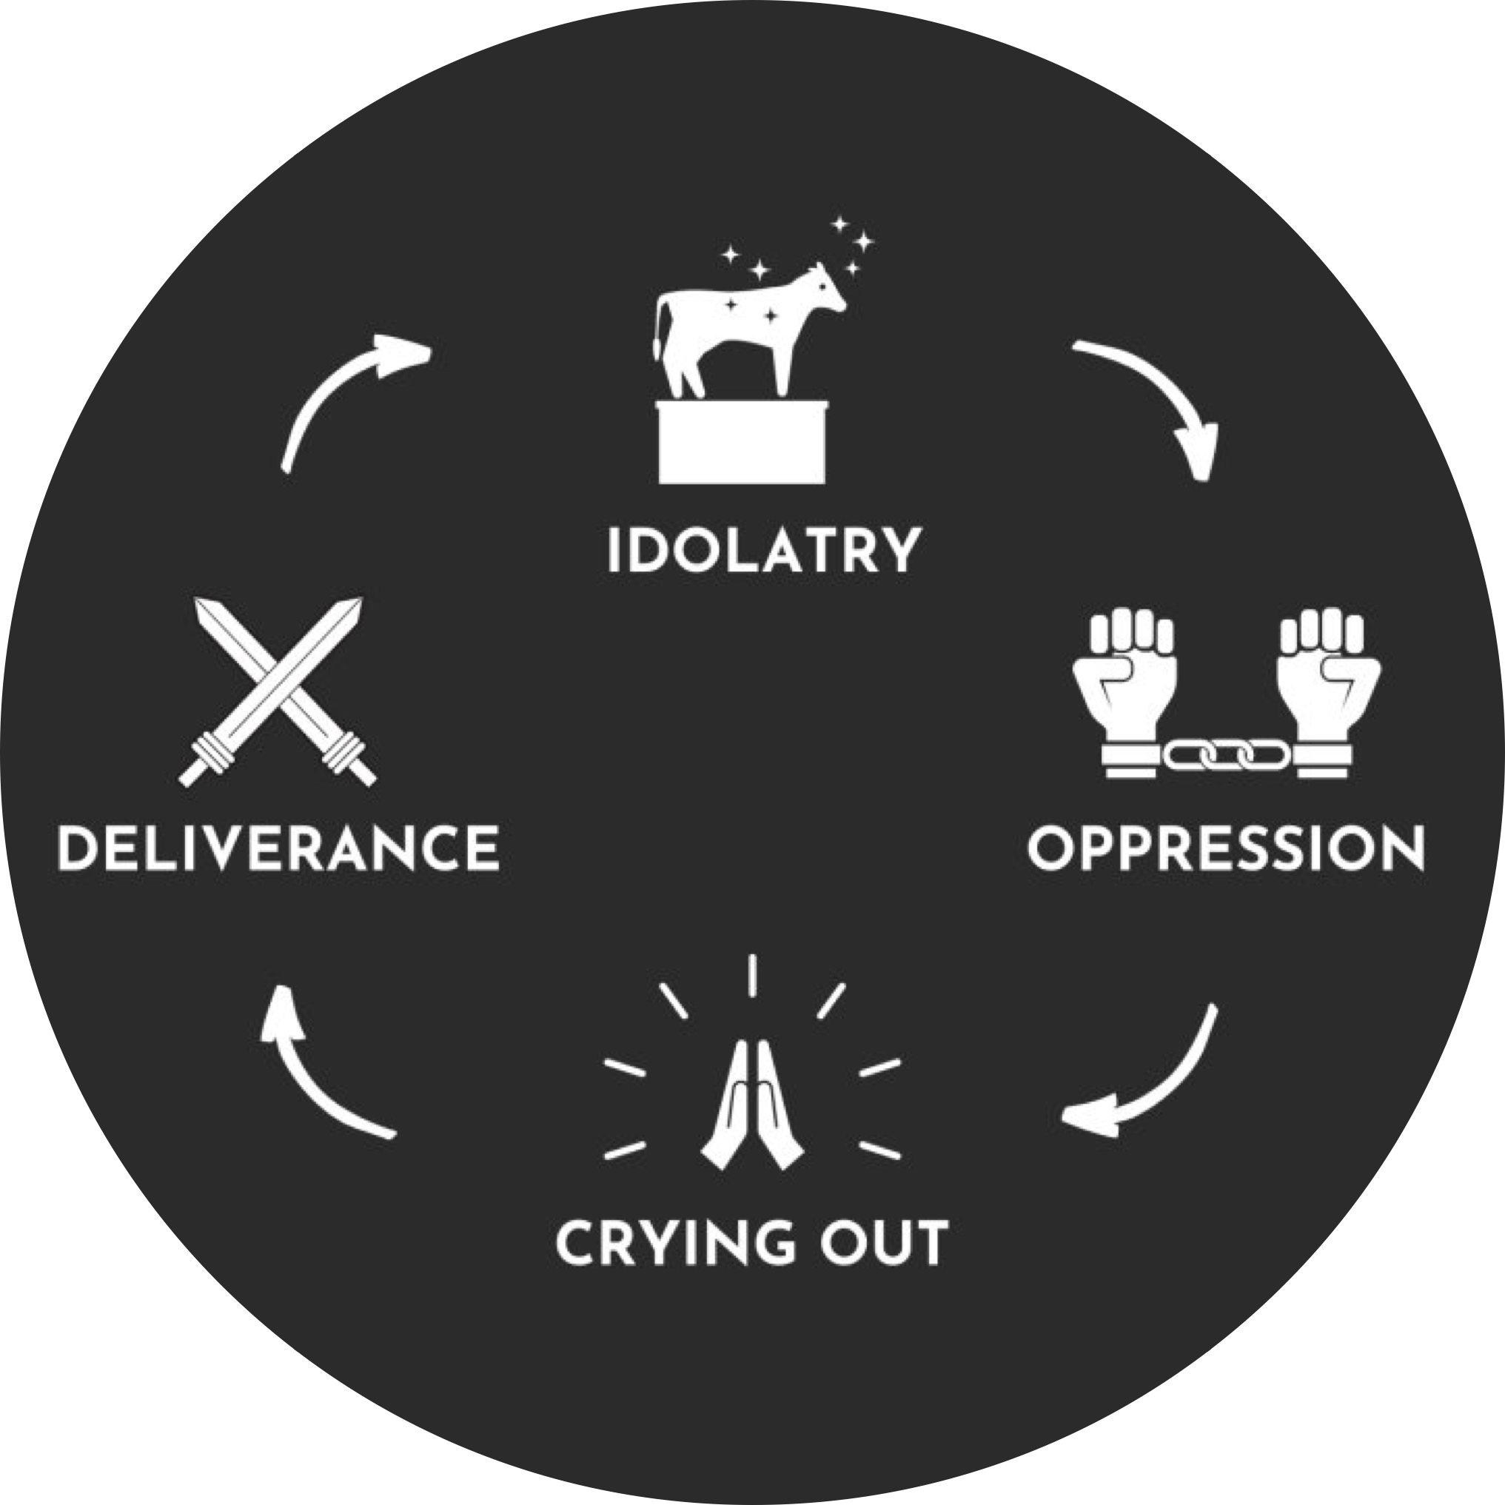
Notes:
The nation gets stuck in sin and false religion– idolatry. This leads to consequences– per the original covenant that they signed up to. That results in them crying out to God for mercy. That results in God coming to deliver them. Then once things are good and they sort of forget, they get back to where they started– or worse. The cycle continues and continues.
This is speaking of they cycle on a national level. But the Old Testament also shares stories of people’s personal walks with the Lord. One of the most central figures is King David.

Slide 25
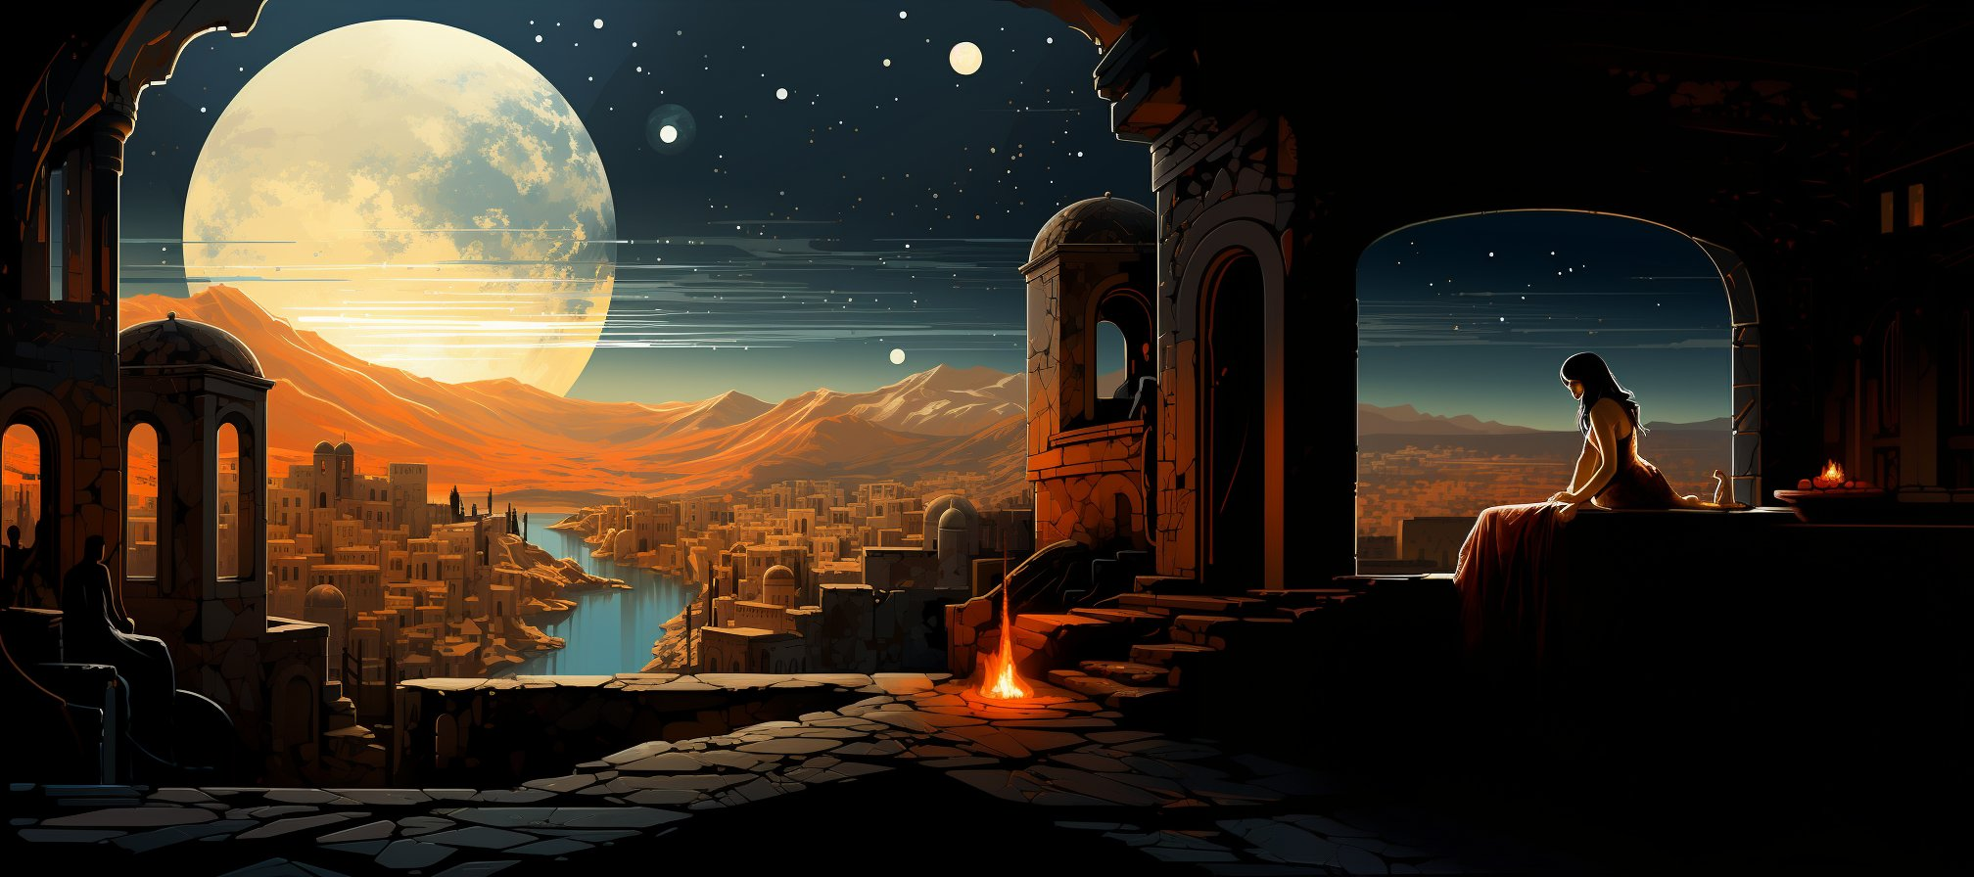
King David’s great needs.
(2 Samuel 11; Romans 4:6-8)
Notes:
David is one of the most profound figures in all of the Bible. We are introduced to him as a young man, willing to fight Goliath armed with a sling, 5 stones, and faith in God. He is annoited as king, but has to tussle with the old king Saul.
He wins wars. Has mighty men. He writes most of the book of Pslams– with deep moving poetry. God calls him a “man after God’s own heart”. Wow– don’t we all wish that is what God thought of us.
But David has another side doesn’t he? I don’t know if you know this, but the law had a specific commandment for Jewish kings– Deuteronomy 17:17– not to have many wives. Now David already had several, but one night he is out on the top of his palace, and he spots Bathsheba taking a bath. In a moment of foolishness– he decides that he needs her. So being king, he makes that happen. The text doesn’t say if it was consensual or not. He is married already, several times over. She is married. It is adultery. When he finds out that she is pregnant, he tries to “deal” with the situation, and ultimately ends up murdering her first husband before adding her to his harem.
God confronts David through the prophet Nathan. David confess and cries out– but the baby dies. David’s kingdom will be split into two. Ultimately David and Bathsheba second son, Solomon will take over follow in his father’s footsteps. Later we read in the text about what King David’s great need really was– forgiveness. David writes “Blessed is the man whose sin the Lord will not take into account”. God promises that Eve’s Savior will be one of David’s descendants– that his kingdom will endure through his son who will be the king of kings.
So, despite our general aversion to it– being “poor and weak”, the Bible teaches is actually is good for us. We have the ability to know what is right to do, but not the ability to do it. That’s what we need!

Slide 26
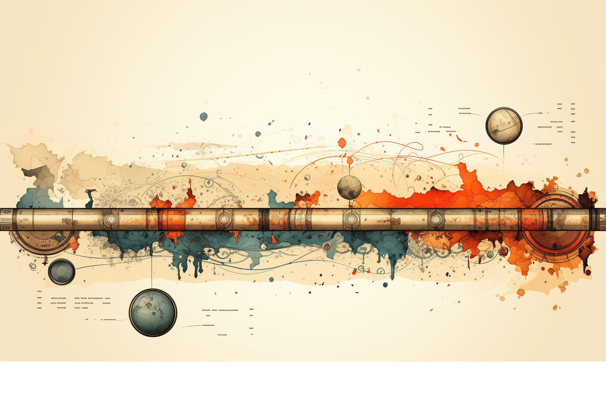
The promise of the prophets.
()
Notes:
The final section of the old testament in our Bibles is focused on the prophets. They give us a lot of details of what exactly Eve’s savior would do, where he would be born, what would happen. Scholars list out 350 specific elements. In the lineage of Abraham. In the lineage of David. Lots of details. For our story this morning, we are focusing on two critical Christmas themes– He would be born in Bethlehem to a virgin.
That brings us to

Slide 27
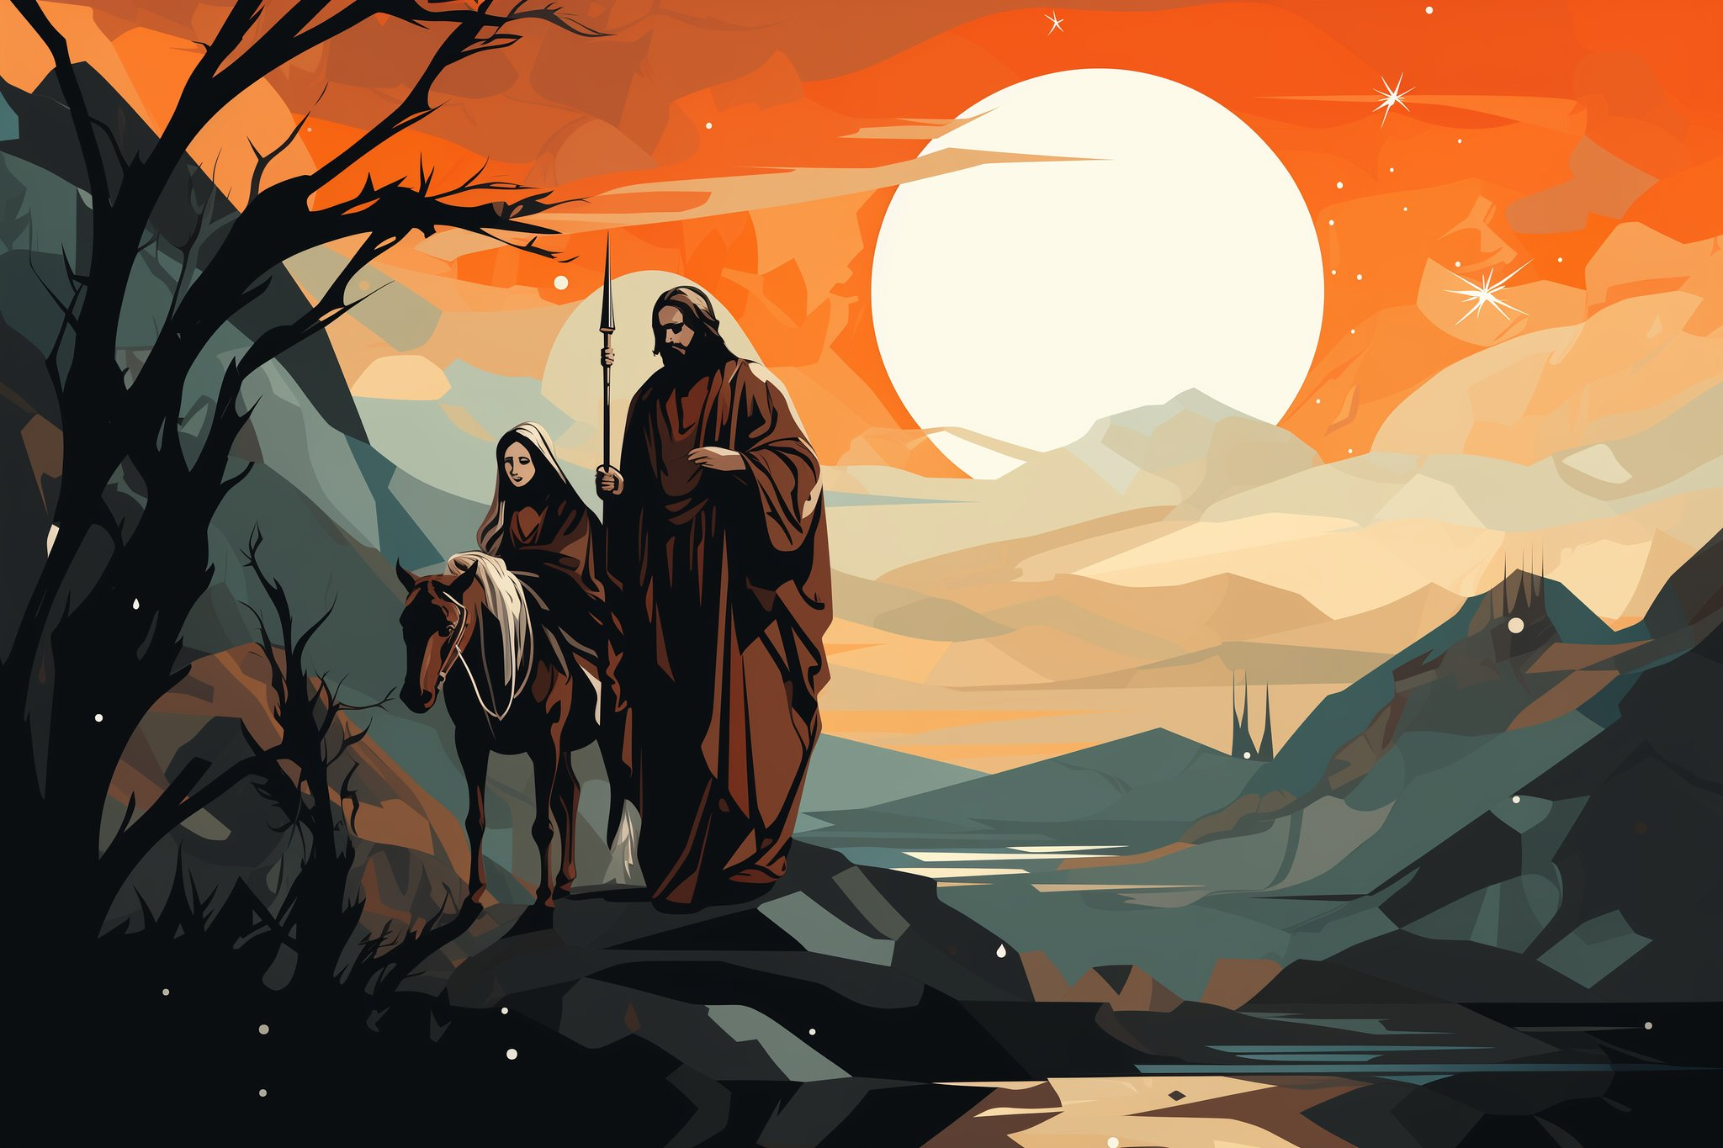
Mary and Joesph
(Luke 1:26-38)
Notes:
An angel appears to Mary and tells her that she is the one. She is the daughter of eve that will bring life, who will give birth to the savior.
She is engaged to Joesph, but still a virgin. A angel has to appear to him too– he was going to end their engagement, for uh, obvious reasons.
They lived up in Nazareth, but due to a Roman decree he had to return to Bethlehem the city of his father in order to be counted in a census.
But this wasn’t just an ordinary baby. He was not a descendant of Adam. He was a “second Adam”, he was not born like we are with a nature that is disconnected from God. Instead this baby was God himself in human form. The prophets had hinted at this, but it was hard for folks to grasp.
The name “Jesus” means ‘God is the one who saves’, and it was very literal.
The serpent is still at work, he inspires a local ruler to kill all of the babies in Bethlehem in an attempt to kill Jesus, but much like Israel, Jesus and his family were rescued by traveling to Egypt for a season. Later his family returns to Nazareth where he grows up, eventually getting a regular job as a construction worker. Although Jesus experienced most of the same things we experience his experience had one key difference. He never sinned. Not even a little. Then at around age 30 he leaves home and starts a ministry.

Slide 28
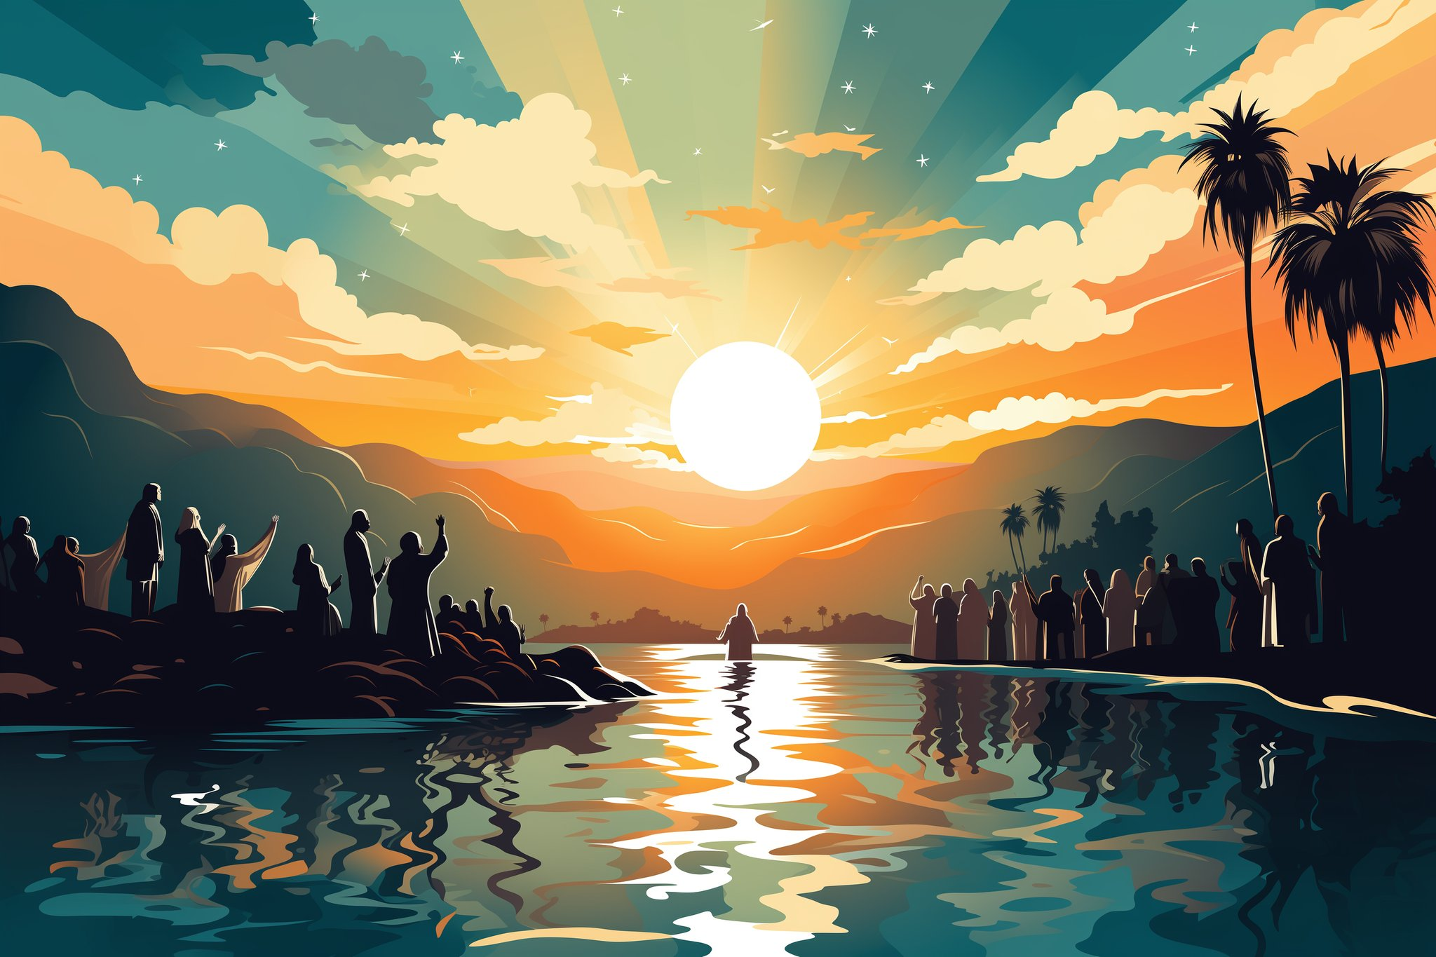
Behold, the Lamb of God who takes away the sin of the world!
(John 1:29-34)
Notes:
Meanwhile God also called a prophet to come and make the path ready for Jesus. His name was John, you know him as John the Baptist. It didn’t have anything to do with a Baptist church, rather he was calling people to turn to God. When John saw Jesus coming to him he supernaturally recognized Jesus for who he really was and he exclaimed– ~
Just like Eve had been taught, and Abel, and Abraham, and Israel through the passover– Jesus was the sacrifice that would restore humanity by removing the consequence for their sins. He was the one who could defeat the rebellion once and for all.

Slide 29

Jesus opens the eyes of the blind.
(Matthew 4:23-24)
Notes:
After Jesus became an adult, he began to do many extraordinary things. He made blind men see and cured those who could not walk. He healed many who were sick—some with terrible diseases like leprosy. Jesus even had power over death. He made people who had died alive again.
On one occasion, he fed a huge, hungry crowd. There were thousands of people and Jesus had only 5 loaves of bread and 2 fish. However, as men helped Jesus pass out the food, the bread and fish kept increasing! Everyone had enough to eat. When they were finished, they even gathered 12 baskets of extra bread. All could see that Jesus loved people. Jesus did these things so everyone would know he was God. These miracles authenticated who He was. They could match what the prophets wrote about to the son of David in front of them.

Slide 30
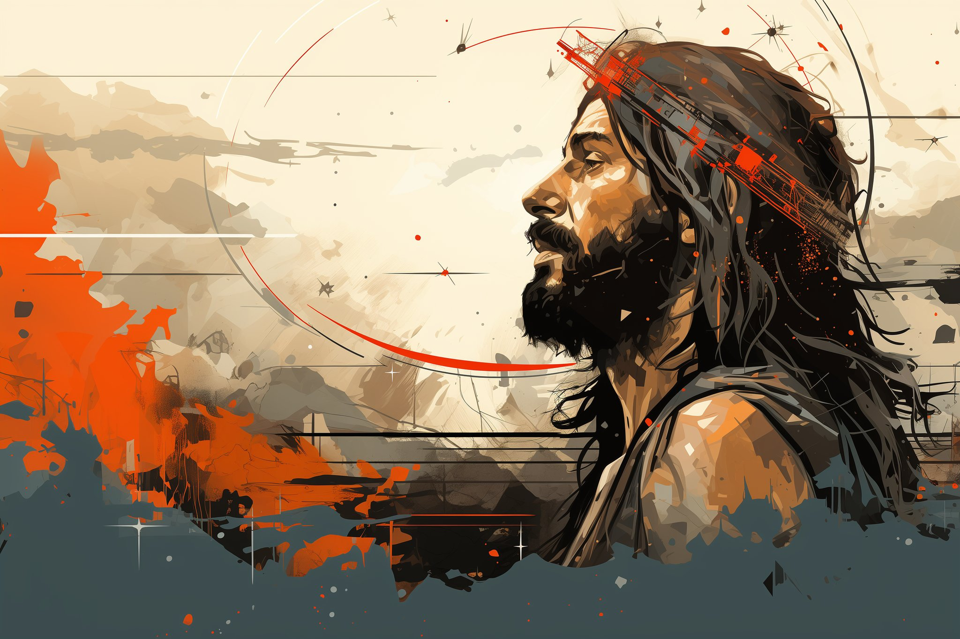
Jesus is rejected & betrayed.
(Luke 22:1-4)
Notes:
The leaders of Israel did not accept Jesus. Like Cain and so many others they had decided to approach God their own way… through legalism. They were too proud to realize that no one could obey the law. The serpent believing that he could kill Jesus and thwart God’s plan takes possession of Judas Iscariot, and Judas goes to the leaders of Israel in order to betray Jesus. Jesus is captured. Mocked. Beaten. He has the power to destroy them all– yet he humbles himself to the point of death.

Slide 31
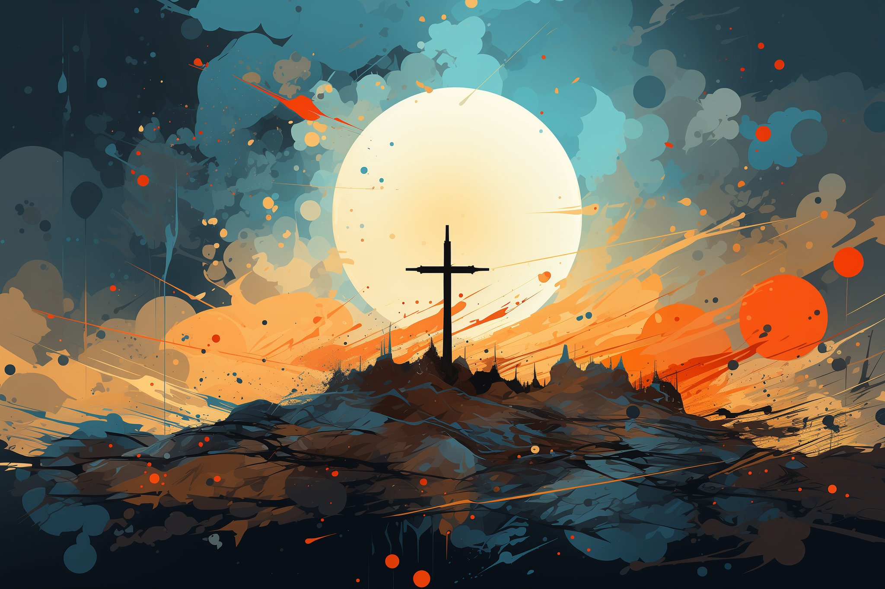
Jesus is crucified.
(John 19:6-30)
Notes:
Death on a cross.
In a moment everything changes. The serpent believes he has won, he has killed God in the flesh.
But what the serpent didn’t realize is that he has been tricked. Jesus wasn’t killed by the serpent or even the Romans. Jesus had willingly laid down his life a the Sacrificial Lamb of God.
What the serpent and mankind had done as evil, God used for good. You see on that cross Jesus cried out “It is finished”. Like the passover lamb – and it was literally the weekend of the passover feast, His death would allow God to be both Just and the Justifier. That God could meet our greatest need– forgiveness because He was willing to give His one and only Son. It is the climax of the entire Bible. The rebellion is dealt its death blow. But there is a plot twist. Just as promised… 3 days later…

Slide 32
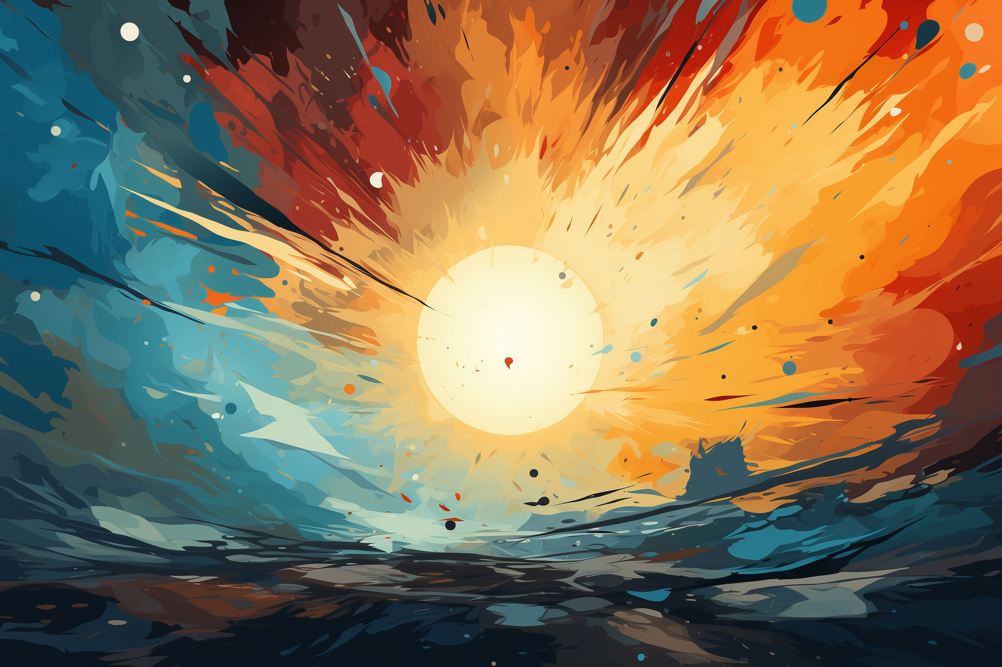
Jesus is resurrected.
(John 20)
Notes:
It turns out that God has power over death. The grave could not keep him. God demonstrates that He has the power to bring us back to life. But Jesus comes and teaches them more… before ascending up to heaven to intercede on our behalf

Slide 33
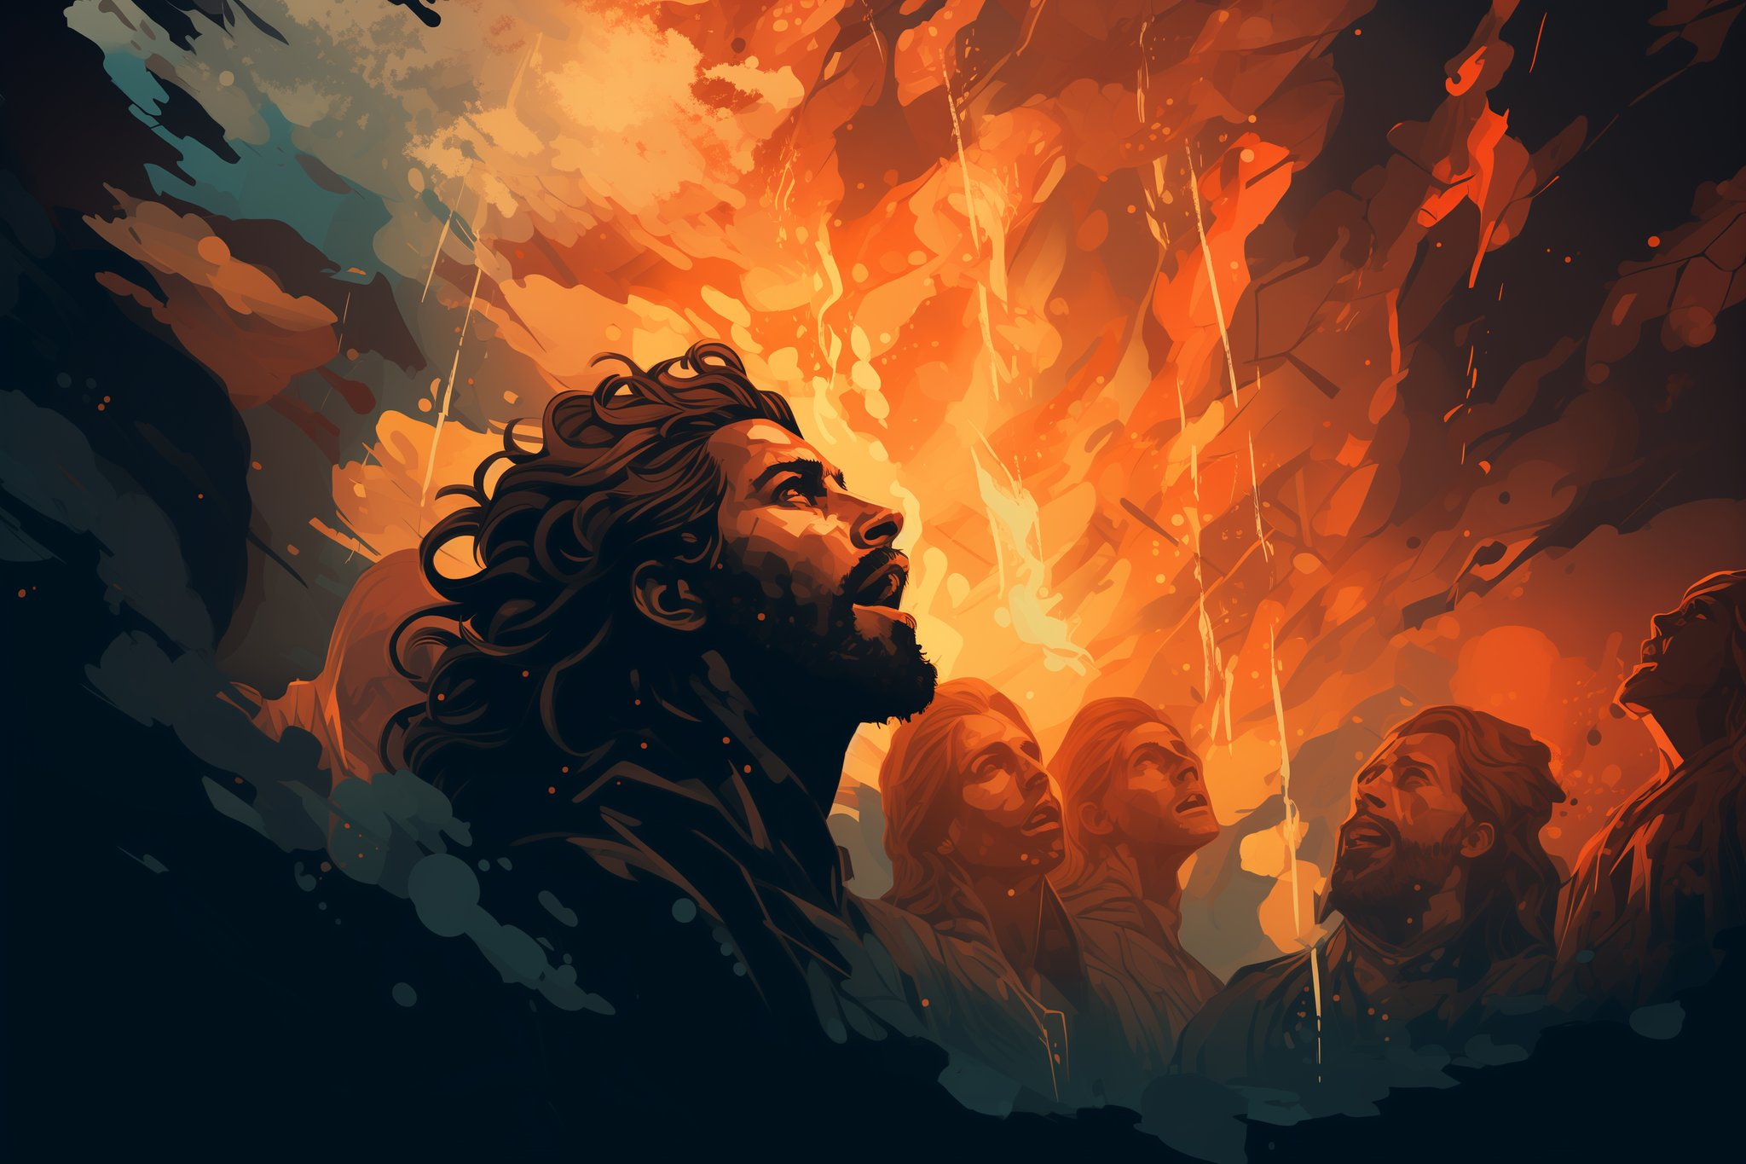
The Holy Spirit descends.
(Acts 2)
Notes:
Jesus tells them to wait 50 days for the coming of the Spirit who would enable them to fulfill the promise made to Abraham, to be a blessing to all nations. So they wait, until the feast of Pentecost, when the Spirit is poured out on Jesus’ disciples.
You see, Jesus the lamb had paid the price for their sins. However, we need more than just forgiveness. We need power to actually live rightly. A list of rules wasn’t going to help. Just like in the garden, the freedom from the power of sin in our life was only possible in close communion with God. Now you and I can experience God’s power in our lives enabling and empowering us to accomplish our mission of being a blessing to the whole world. We accomplish this mission by telling others about this story that matters. It is the story of the good news– the gospel.

Slide 34

Missional living.
(Romans-Jude)
Notes:
Most of the rest of New Testament is a series of encouraging letters to cultivate our relationship with God. Explaining how to walk in the power of the Spirit. The serpent realizes he is defeated, but is still trying to deceive us and distract us from our mission of sharing this story. We are waiting for the final chapter to be expereinced. Right now God is fulfills his promise to be a blessing to all the nations through us. Our purpose, our reason for being is to be God’s ambassadors. At some point God will declare that blessing is complete and thus will begin the final judgment and harvest. It is when Jesus returns not as the suffering servant but as the King of Kings and Lord of Lords.

Slide 35


Jesus returns.
(Revelation 19)
Notes:
When our mission is complete Jesus will return to finish all that was promised by the prophets. The serpent is bound and no longer has influence on this earth. Instead Jesus rules and reigns as king of kings and Lord of Lords.
This reign is for 1000 years. Then Satan is released for a short season, during which he deceives some and tries one final time to overthrow God. It ends in failure, and he and the rest are tossed into the lake of fire for their eternal destruction.

Slide 36
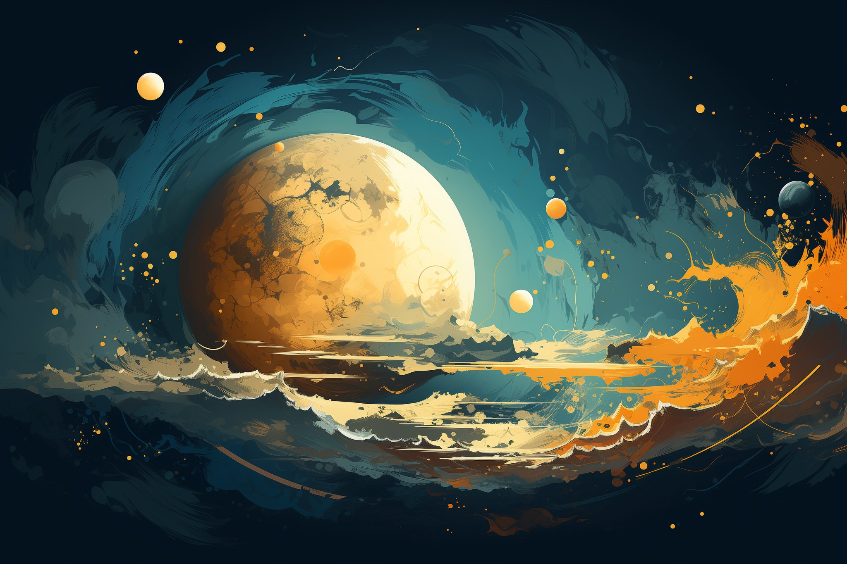
New heavens
& New Earth
(Revelation 21)
Notes:
With all sin and evil dealt with, God creates a new heaven and new earth– all traces of rebellion eliminated. God, angels, and humanity all living in relationship.
The Bible doesn’t use these word– but the implication is that we live happily ever after.

Slide 37
Know the story
Meet the Author
Notes:
If you can see the design in our humanity, let me challenge you to meet the Designer. His name is Jesus.

Slide 38

Come receive the water of life without cost
(Revelation 22:17 )
Notes:
One final slide. It is quote from the last page of the Bible. It reads like this.
The Spirit of God is inviting you.
The bride, refers to the church of God– we are inviting you.
Each and one of us who has come to Jesus– we are all inviting you.
If you recognize that you have a need for God– that you are thirsty, you are invited to come.
Know this, this eternal life which is impossible to obtain by our own works is freely offered by Jesus. Your works do not earn it. Your works do not receive it. Your works do not keep it. It is a free gift to those who rely on the promise… of the Story That Matters.

